Slide 1
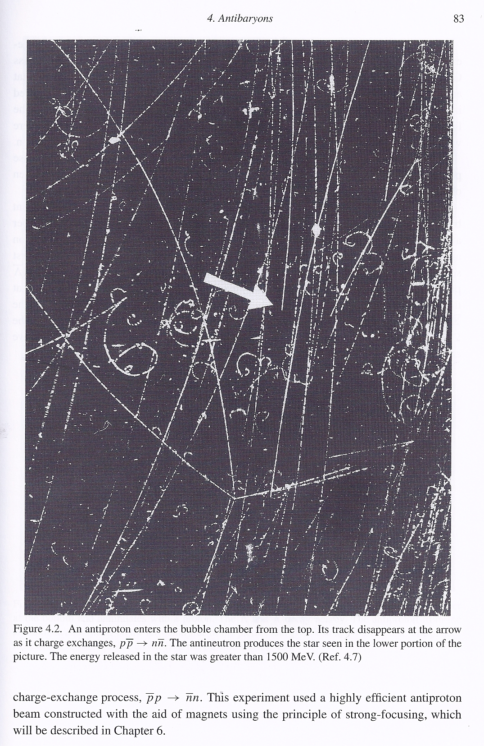
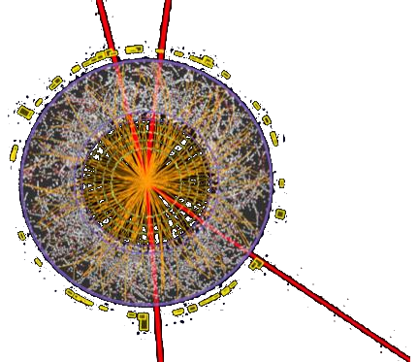




CERN in the classroom:
cloud chambers
Elementary
a collaboration:
http://CERNandScotland.tumblr.com
Notes:
Direct link between cloud chambers and current CERN state-of-the-art experiments

Slide 2
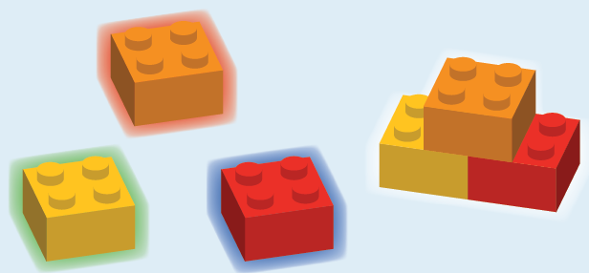
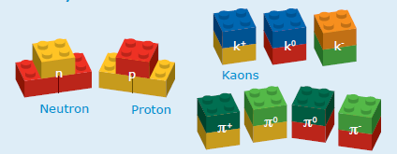
Particle Physics: the ‘building blocks’
SEPnet
Notes:
what is particle physics all about?
– elementary constituents; ‘building blocks’

Slide 3

Cloud chamber
invented 1911 by Scottish
physicist CTR Wilson
+12ºC
isopropyl alcohol (volatile)
falls in high temperature gradient
layer of supersaturated
vapour forms
–70ºC

Slide 4
+12ºC
high-energy particle goes through
–70ºC

Slide 5
+12ºC
+
–
–
strips electrons from gas
molecules as it passes
+
+
–
–
+
–
+
+
–
–70ºC

Slide 6
+12ºC
ions nucleate liquid drops in the supersaturated gas
–70ºC

Slide 7
+12ºC
the droplets reflect light and
we can see the particle’s track
–70ºC

Slide 8
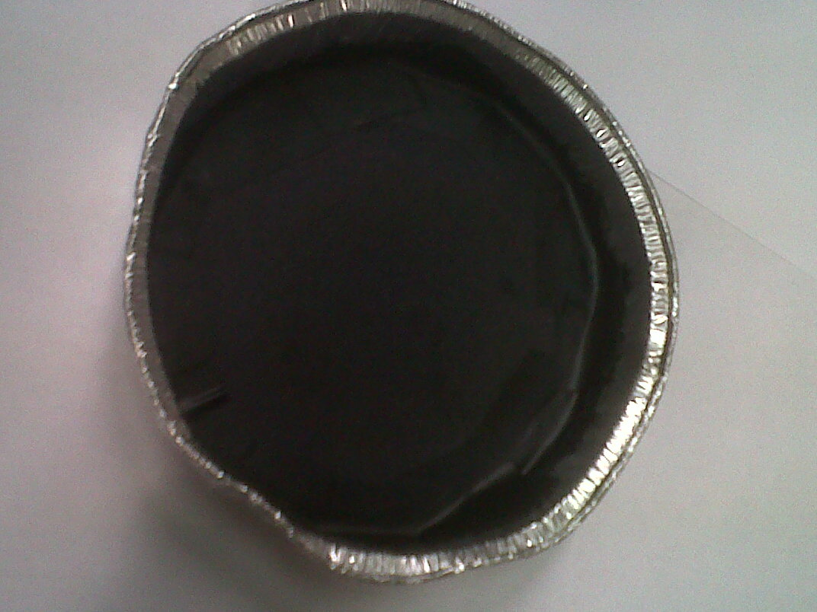
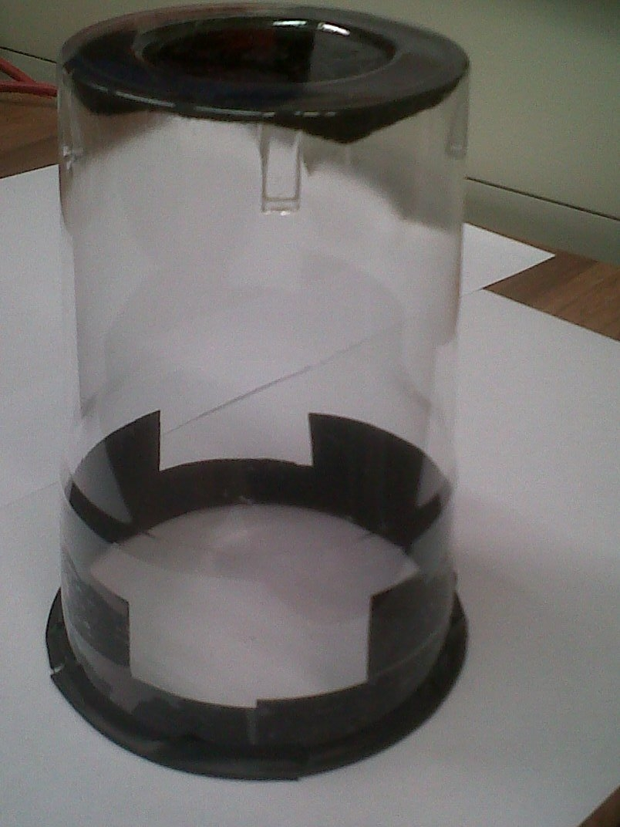
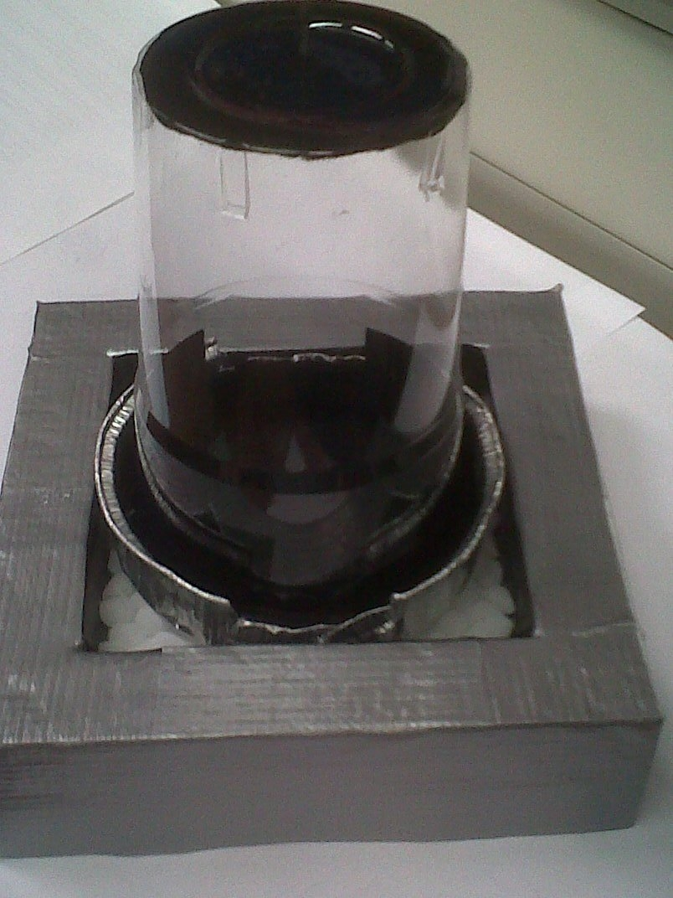
Safety!
isopropyl alcohol
dry ice

Slide 9
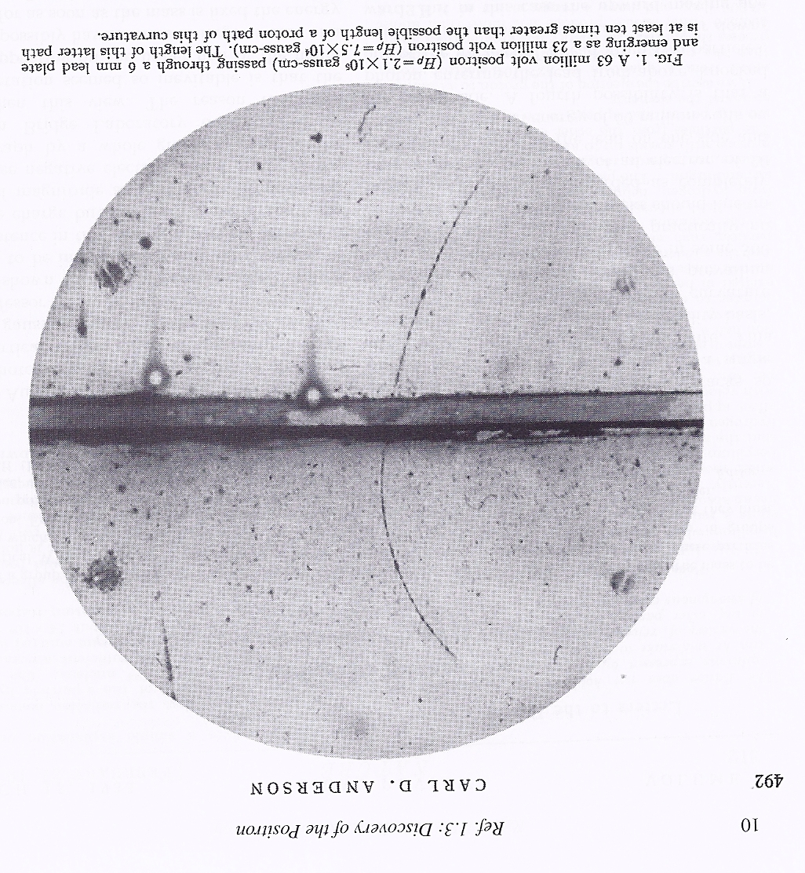
After the atom: a new particle 1933
positron
1933
Physical Review 54 (6)
491–494 (1933)
Notes:
cloud chamber used for positron discovery
positron travelling upward (loses energy in lead plate so higher curvature above the plate; known direction of magnetic field determines charge)

Slide 10
The discovery of the antiproton
and other antimatter, 1955-59
Notes:
-> bubble chamber; same principles

Slide 11
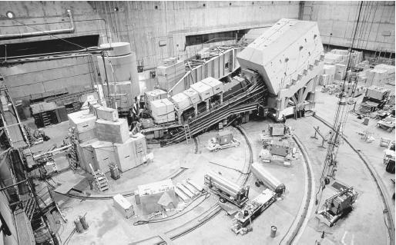
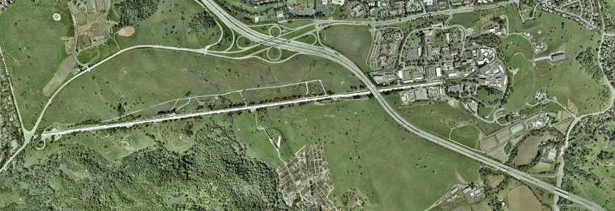
Controlled environment and
higher energies: accelerators
Stanford linear accelerator (1960)
Glasgow electron microscope
Stanford linear accelerator (1960)
Notes:
rather than wait around for cosmic rays, control the environment -> accelerators

Slide 12

The Large Hadron Collider
Notes:
Built the Large Hadron Collider
- world's biggest machine, 27km round
100m underground, colder than outer space 1.7K,
hotter than inside the sun

Slide 13
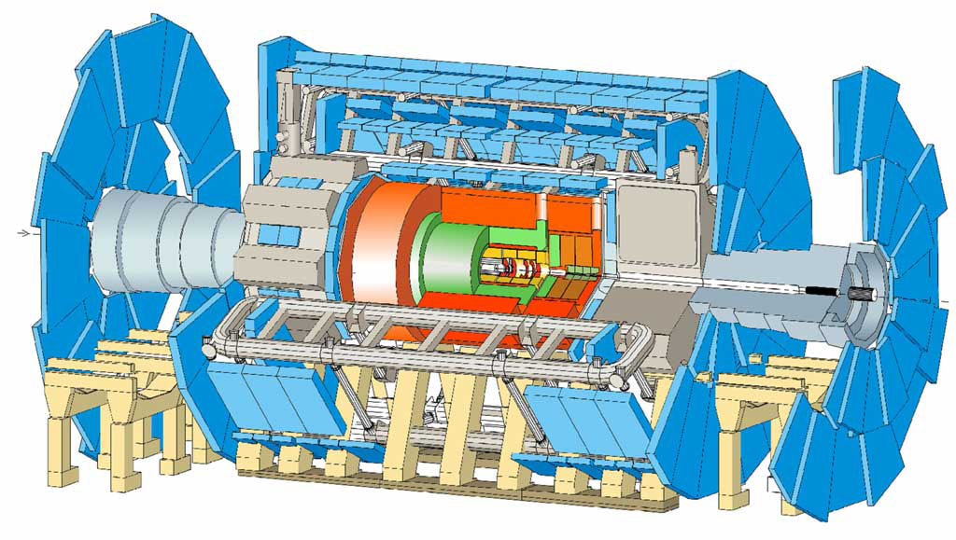
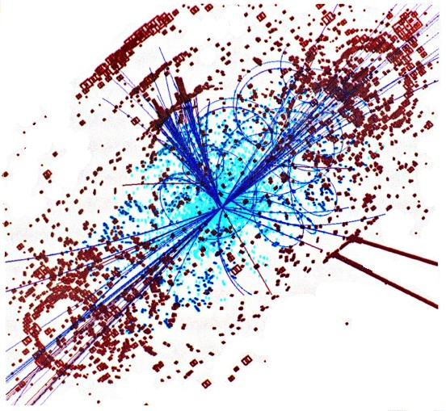
The ATLAS experiment
– reconstruct particle tracks
Notes:
Particle tracks inside the detectors – same idea as the cloud chamber tracks but need to read it out 40M times per second.

Slide 14
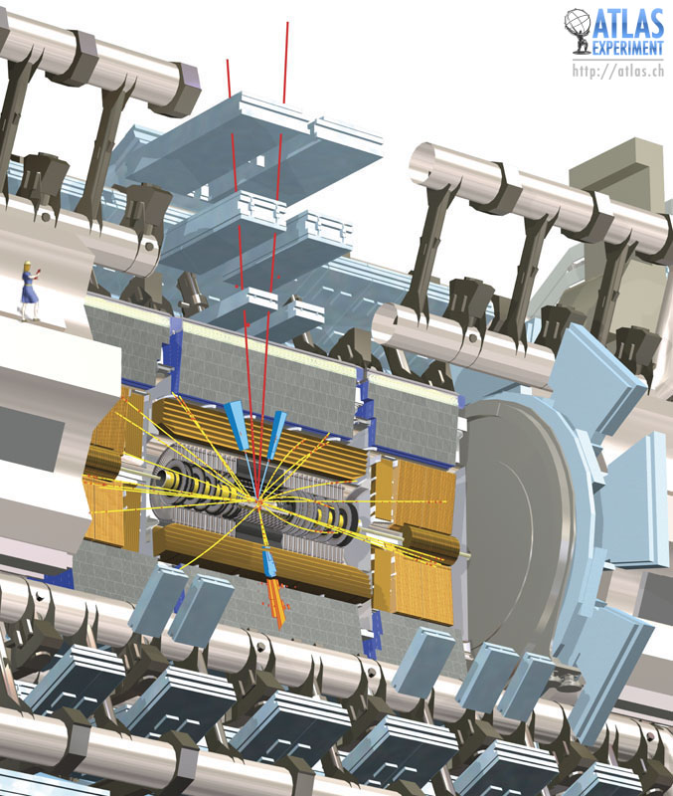
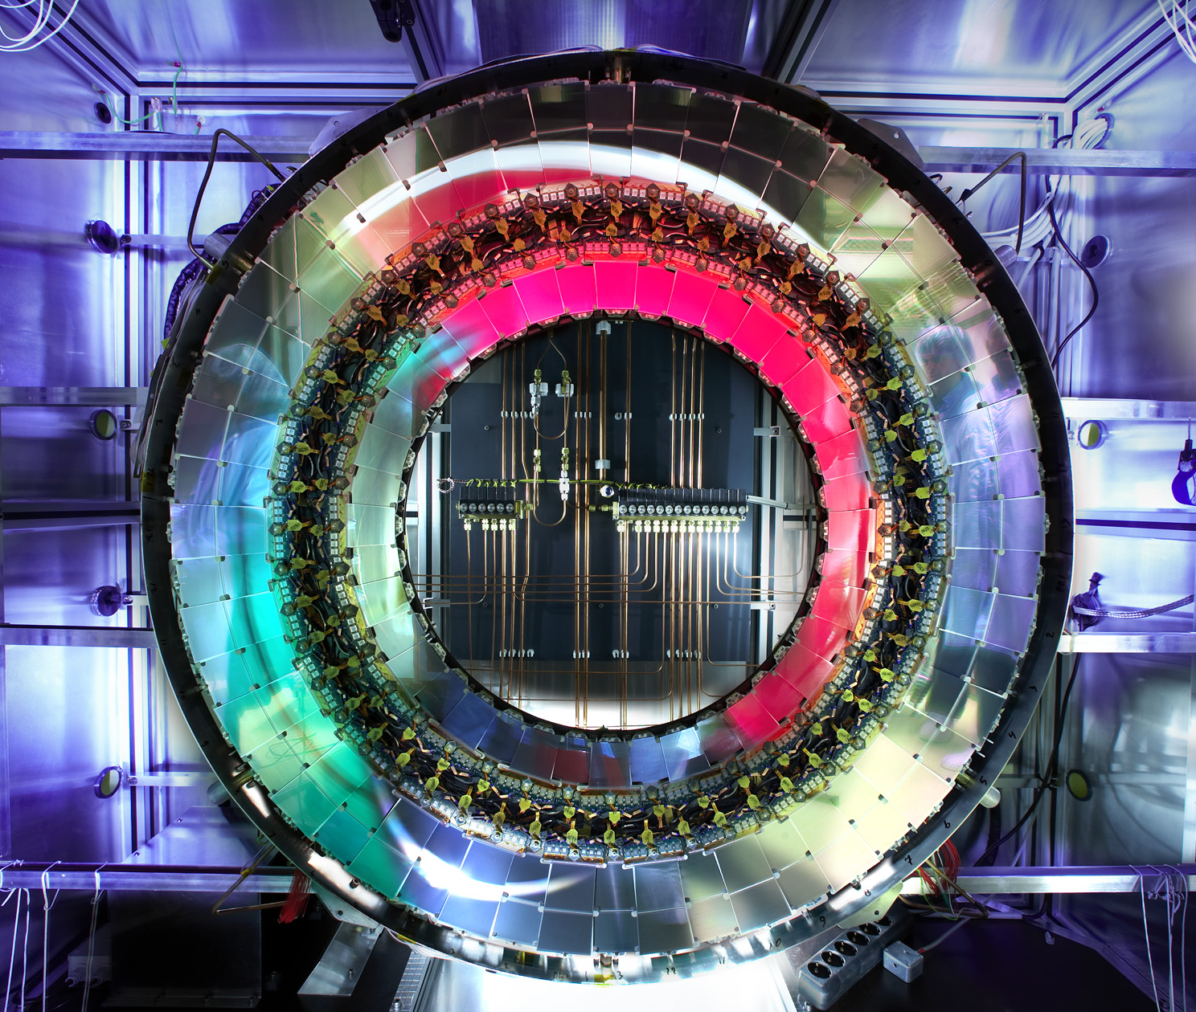
Notes:
100Mpixel 3-D digital camera taking 40M photos per second – what it actually looks like.

Slide 15
From cloud chambers
to Higgs at the LHC

Slide 16



http://CERNandScotland.tumblr.com

