Slide 1
H&S considerations
for PPE Group
Infrastructure & issues and solutions for ATLAS Upgrade Hybrid/Module strip bonding
Health & Safety Induction for PPE Group staff & students
Notes:
1
1
1

Slide 2
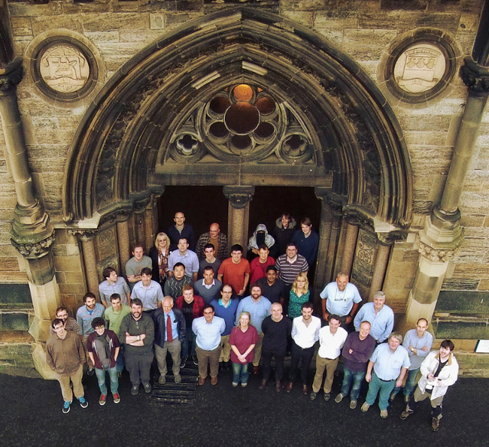
PPE GROUP
Fred Doherty, H&S Induction, GU
2
Notes:
2
2
2

Slide 3
University Online Induction Training
Induction Training
All new members are required to complete the University's Health and Safety Online Induction. The purpose is to ensure they are aware of their health and safety responsibilities and remain safe during the course of their work.
It is important that management units also take steps to formalise the information given to new members, by their immediate manager or local Safety Coordinator, by having a local safety induction. This should include site orientation, fire evacuation procedures, accident reporting, location of first aiders, site rules and results of any risk assessments that have been undertaken.
Records of this training must be kept as evidence that this training has been given and to assist in identifying any future training.
Fred Doherty, H&S Induction, GU
3
Notes:
3
3
3

Slide 4
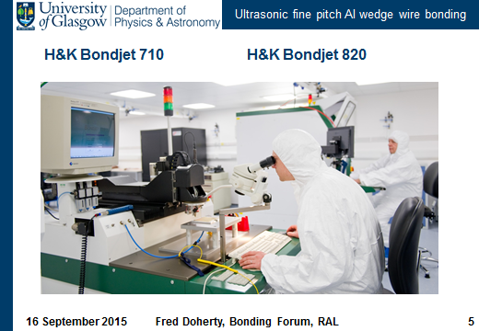
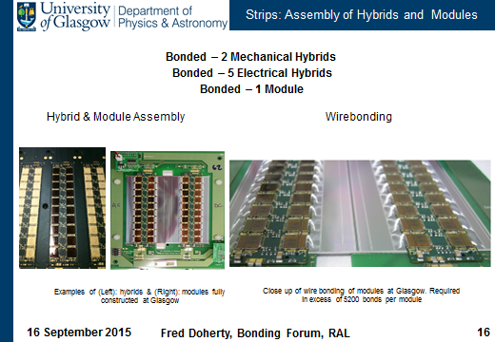
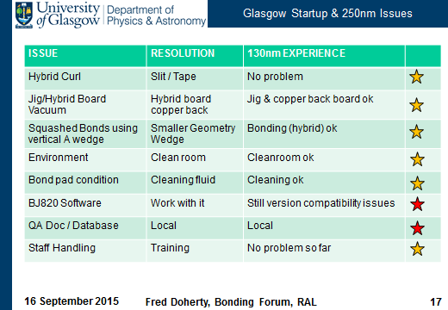
Table of contents
Presentation plan
Group Safety – Personnel /Training / Personal Safety
Induction & Training Personal Review Spreadsheet
Glasgow University Online E- Induction
Fire Safety
Wardens / Assembly Points / Evacuation
Accident or illness First Aid
GLADD 1 & 2 Cleanroom Procedures
Safety for possible work requirement areas
Heavy Lifting / Working at Heights / Gas / HV / Radiation /
X-Rays / Chemicals / Cryogenics / Lasers
Working Outwith Normal Hours
Safety & Travel - Fieldwork
Fred Doherty, H&S Induction, GU
4
Notes:
4
4

Slide 5
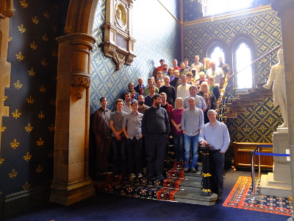
Group Safety
Safety Personnel
Fred Doherty – School Safety Committee.
Jill Sambrook – Induction Coordinator.
Fiona Grant – First Aid Contact.
Safety Training
University Health, Safety & Wellbeing E–Induction
PPE Group Safety Induction talk.
PPE Group Introductory info & tour of labs.
Further Training when required.
Personal Safety Outcome
Induction & Introductory information will cover general basics of safety and areas relevant to working in the PPE labs.
You should identify your training needs and safety considerations In consultation with your supervisor.
Ongoing assessments with supervisors, safety personnel and annual PDRs should clarify requirements for each individual.
Fred Doherty, H&S Induction, GU
5
Notes:
5
5
5

Slide 6
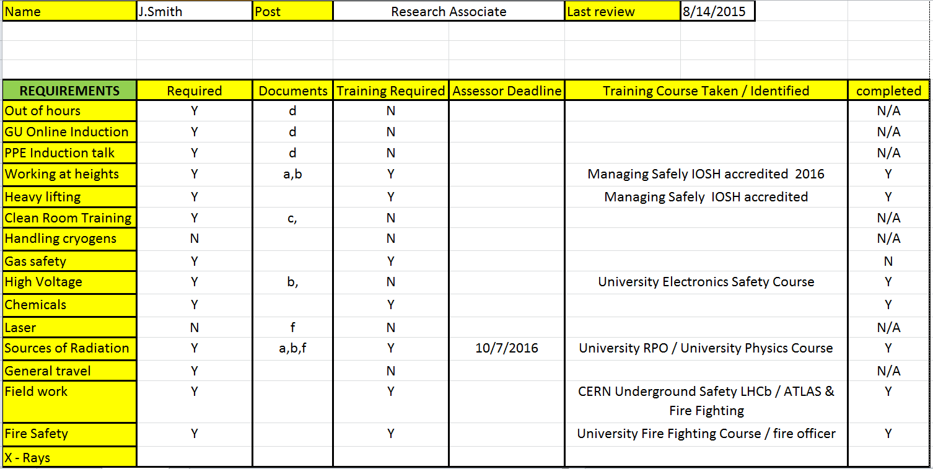
Induction & Training Review Spreadsheet
Personal Induction & Training Review Spreadsheet
Fred Doherty, H&S Induction, GU Meeting
6
Notes:
6
6
6

Slide 7
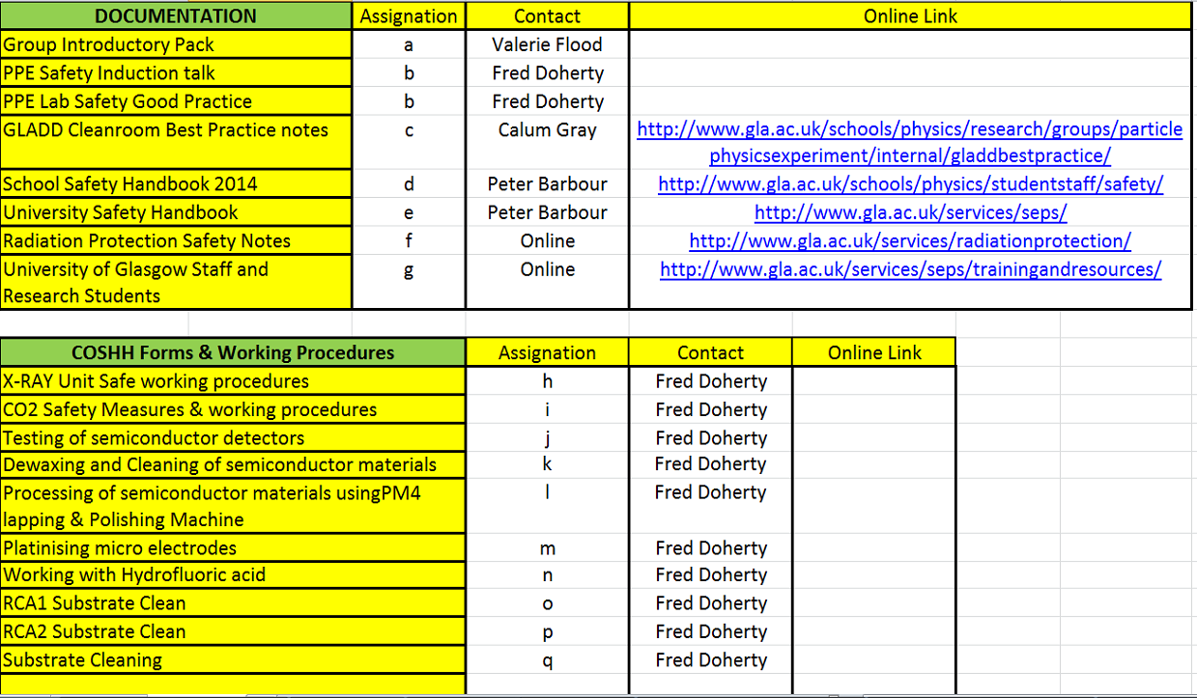
Induction & Training Review Spreadsheet
Personal Induction & Training Review Spreadsheet
Fred Doherty, H&S Induction, GU Meeting
7
Notes:
7
7
7

Slide 8
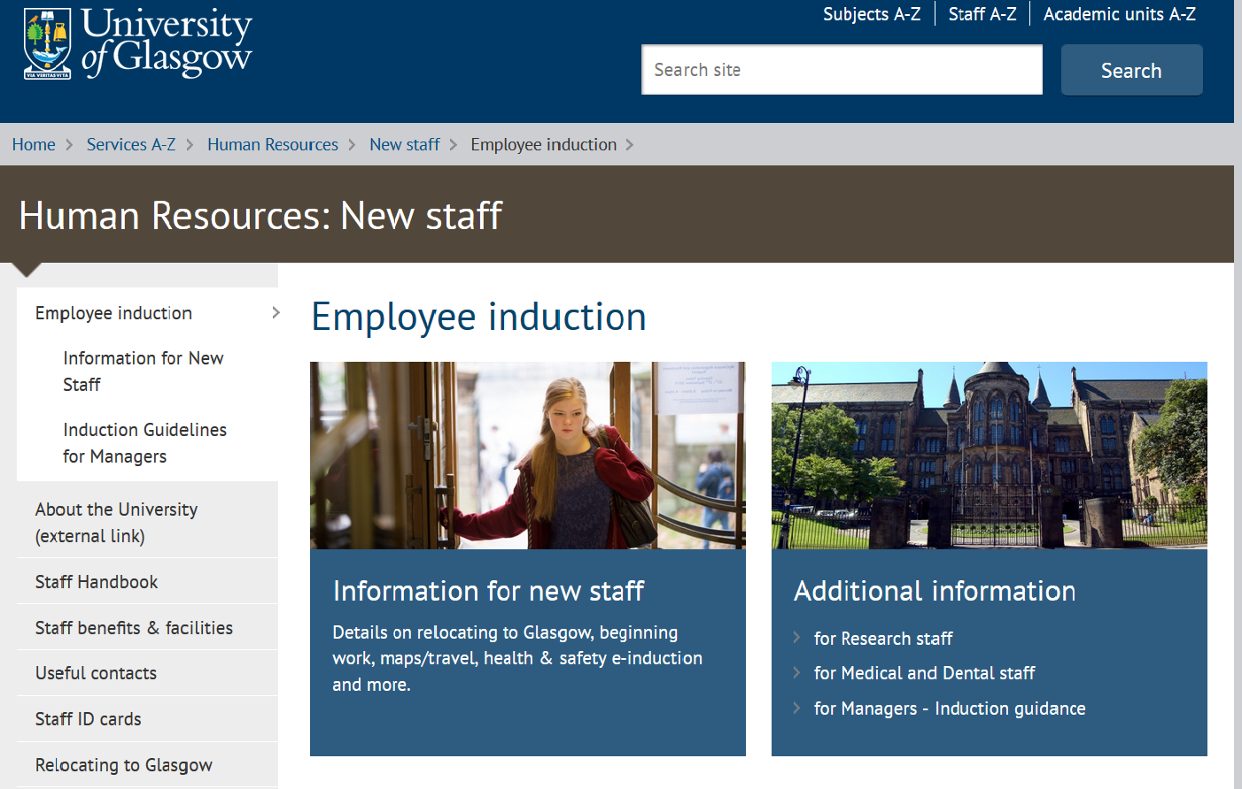
HR New Staff Online E-Induction
Glasgow University New Staff Online E- Induction
Fred Doherty, H&S Induction, GU
8
Notes:
8
8
8

Slide 9
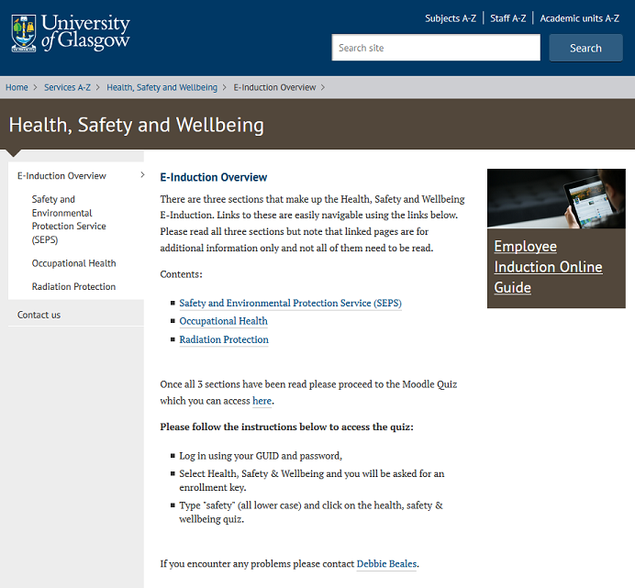
E – Induction Overview & Quiz
E- Induction Overview -
Safety & Environmental
Protection Services,
Occupational Health &
Radiation Protection
Fred Doherty, H&S Induction, GU
9
Notes:
9
9
9

Slide 10
Kelvin Building Fire Wardens
Kelvin Building Fire Wardens
Area Fire Officer Mr Colin Craig Deputy Fire Officer Mr David Truesdale Ext 5901 or 07748155509 Ext 6400
Old Building
Fire Wardens Area Covered
Mr Mike Perreur-Lloyd East Perimeter Level 4 #
Pending West Perimeter Level 4 #
Mr Steven O’Shea West Perimeter Level 3 #
Mr Calum Gray East Perimeter Level 3 #
Dr Bryan Barr East Perimeter Level 2 #
Dr Morag Casey West Perimeter Level 2 #
Pending Computer Lab Level 2 #
Mr Brendon McGill West Perimeter Level 1 #
Pending East Perimeter Level 1 #
# - Exit via Old Building (South Entrance) - Assembly Point 3
Fred Doherty, H&S Induction, GU
10
Notes:
10
10
10

Slide 11
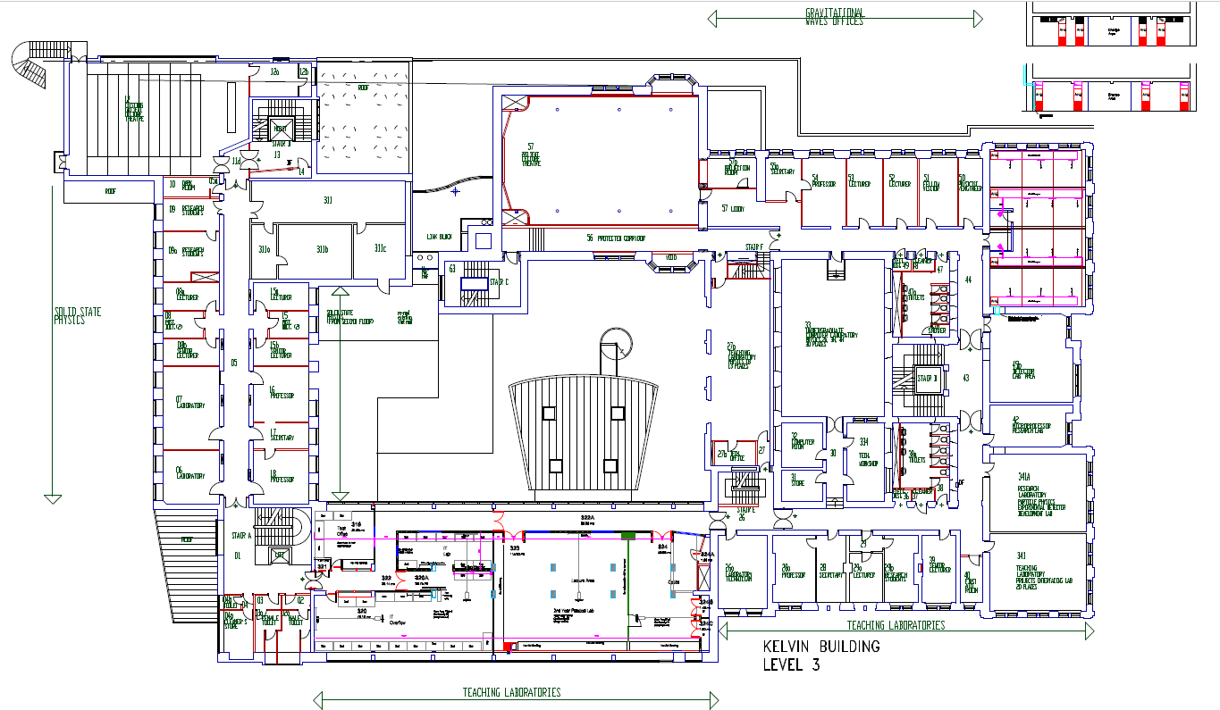
Kelvin Building – Fire Assembly Points
PPE Group - Site Orientation
Fred Doherty, H&S Induction, GU
11
Notes:
11
11
11

Slide 12
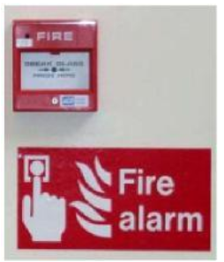
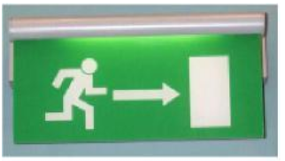
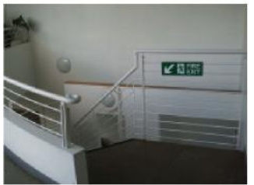
Kelvin Building Fire Evacuation
You should familiarise yourself with the escape routes from the premises & position and operation of Fire Alarm Call Points.
On Discovering a Fire:
Raise the alarm by operating the nearest Fire Alarm Call Point an electronic sounder will then sound continuously.
Evacuate the building by proceeding to the designated assembly point
On Hearing a Warning of Fire
Evacuate the building quickly and calmly (Proceed to the designated assembly point)
Fred Doherty, H&S Induction, GU
12
Notes:
12
12
12

Slide 13
Kelvin Building Fire Evacuation
On Both Occasions:
Do not delay your departure by collecting personal belongings
Where possible close room doors behind you
Do not use lifts
Do not re-enter the building until a Fire & Rescue Officer has stated that it is safe to do so.
Do not fight a fire if:
It is dangerous to do so
You are on your own
There is a possibility of your escape route being cut off by fire or smoke
The fire continues to grow
The fire involves hazardous materials
If in doubt get out
Fred Doherty, H&S Induction, GU
13
Notes:
13
13
13

Slide 14
Accident or Illness - First Aiders
Accident or Illness
In the event of a serious accident or sudden illness you should dial 4444 and ask for an ambulance then summon a first-aider.
A list of first-aiders is given below.
If the accident involves chemicals, full written details should be sent with the patient.
In the event of a less serious accident or illness you should summon a first-aider. If the first-aider decides that hospital treatment is required then contact Main Gatehouse to call an ambulance. If no first-aider is available contact Main Gatehouse Ext 4282 and First Aid trained Security Staff will attend.
Kelvin Building First Aiders
Ms L Murray Room 317 Ext 4717
Mr S Craig Room 203 Ext 5901
Mr D Doak Room 140 Ext 6412
Mr P Macmillan Janitor Desk Ext 4465
Mrs F Grant Room 339 Ext 6423
Location of PPE First Aid Boxes
Level 1 : Room 148
Level 2 : Janitor's Desk and Rooms 203, 206 and 216
Level 3 : Room 319, 339, 341, 341a (GLADD2),345, 346 (GLADD1) and 350
Level 4 : Room
Fred Doherty, H&S Induction, GU
14
Notes:
14
14
14

Slide 15
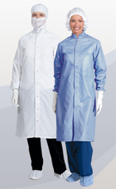
Glasgow Advanced Detector Development Clean Room Facility - GLADD
Main Cleanroom Procedures
The clean room is a restricted area; only TRAINED and AUTHORISED users may enter.
No more than 6 PEOPLE should be in this laboratory at any one time.
DOORS should not be held open longer than necessary.
There should be NO EATING, DRINKING or CHEWING GUM in the clean room. Use of PHONES is prohibited.
Full clean room ATTIRE MUST ALWAYS be worn in the clean room.
EXCEPT IN CASE OF EMERGENCY, such as fire alarm or evacuation, personnel should not wear CLEAN ROOM ATTIRE outside of the clean room/changing area.
NO FIXTURE OR EQUIPMENT should be brought into the clean room without prior approval.
Fred Doherty, H&S Induction, GU
15
Notes:
15
15
15

Slide 16
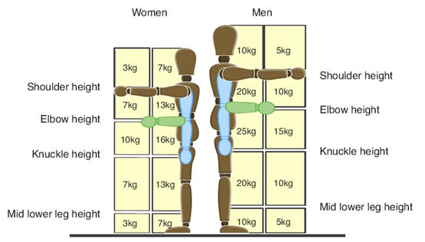
HEAVY LIFTING
The regulations do not specify safe weights because capability is so variable. Figure 1 provides a guide to the reduction in capability when lifting loads to different heights and distances from the body. It assumes a 25 kg load to be within a mans capability when a simple straight lift to waist height is involved. No single person should be required to lift, lower or carry loads over 25kg. This limit would only apply when the load is within the individuals capabilities and when no other risk factors are present e.g. bending
IF EVER IN DOUBT USE A TROLLEY FROM STORES OR ASK FOR ASSISTANCE.
IF LIFTING BEND YOUR KNEES NOT YOUR BACK AND KEEP LOAD CLOSE.
THINK DISTANCE TO BE MOVED, SIZE & SHAPE, WORKING ENVIRONMENT, FITNESS, REPETITION.
HEAVY GAS CYLINDERS SHOULD ONLY BE MOVED BY TECHNICAL STAFF.
ALWAYS WEAR SAFETY SHOES WHEN MOVING HEAVY LOADS.
GLASGOW LINKS : http://www.gla.ac.uk/services/seps/az/manualhandling/
HSE LINKS : http://www.hse.gov.uk/msd/faq-manhand.htm
Fred Doherty, H&S Induction, GU
16
Notes:
16
16
16

Slide 17
WORKING AT HEIGHTS
Within the PPE Group labs there should be no requirement to work at height. All lab experiments / research are normally bench height based.
There is provision of step/work stools throughout the labs for access to hard to get to electrical overhead sockets and service connections in the GLADD Cleanroom.
If working at height at CERN, training courses are provided there.
Supervisors should ascertain whether working at heights may be involved in any work at other external sites and arrange suitable training at that site or here at Glasgow.
The Regulations set out a hierarchy of control measures which duty holders are required to follow when planning work at height:
Avoid working at height if possible
Prevent falls through:
use of an existing safe place of work or means of access
use of the most suitable way of working
selection of the most suitable work equipment
Minimise the distance and consequences of a fall should one occur.
The provision of information, instruction and training, where necessary, is also an important factor
.
Glasgow Link: http://www.gla.ac.uk/services/seps/az/workatheight/
Useful information on the prevention of falls from height is available from the HSE website at http://www.hse.gov.uk/falls/index.htm
Fred Doherty, H&S Induction, GU
17
Notes:
17
17
17

Slide 18
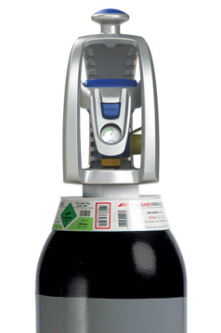
Gas Safety
Only technical staff should be involved in the safe handling, installation & storage of gas cylinders.
New larger 300bar Nitrogen cylinders are currently in use. These are higher-pressure cylinders for more gas and fewer changeovers. Link : http://www.boconline.co.uk/en/new-300-bar-cylinders/index.html
Please see technical staff for guidance on the Regulation / adjustment of gas from all group cylinders.
Nitrogen Gas is currently distributed to the GLADD facility from lab 345.
Nitrogen can cause asphyxiation in very high concentrations if there is a gas leak (they do not support life, hence adhere to precautions above).
Fred Doherty, H&S Induction, GU
18
Notes:
18
18
18

Slide 19
Electrical Safety – High Voltages
Main Points
High and low voltage electrical Power Supply Unit sources can be dangerous. Never use exposed electrical wires in research setups. Ensure all wires and connectors are insulated and have insulation rated for the maximum applied bias.
All High voltage supplies used in labs are usually supplied by companies such as Keithley, RS & Farnell. These will have user guides for safe use.
Know your cable type when putting experiments together. Never exceed cable / interconnect specified working parameters.
Inform technical staff of any problems concerning electrical equipment within the lab. Do not go ahead and modify or try to repair the equipment yourself
All electrical units including HV units are PAT (Portable Appliance Testing) tested and labelled.
If in any doubt about electrical work you will be undertaking please contact your supervisor or a member of technical staff.
Fred Doherty, H&S Induction, GU
19
Notes:
19
19
19

Slide 20
Radiation Safety
Ionising radiation is dangerous and can cause cancer. Exposure can go unnoticed at the time of use and may only be years later that the effects of reduced life expectancy and quality of life are experienced. Therefore it is of the upmost importance to be extremely careful in their use for your own safety and the safety of others
Irradiated material (or unknown materials) intended to be taken into the PPE group labs will be checked first by the Radiation Protection Officer, before being allowed into the lab for use and storage. This irradiated material should be stored in the large storage safe located in Semi Clean Room 341a.
All experiments and demonstrations involving the use of ionising radiation should be carefully prepared with a view to minimising radiation exposure at all times
Adequate supervision of undergraduates must be provided and instruction in correct handling techniques with a brief explanation of the hazards involved should precede the actual experiment.
Basic rules would include - don’t look into them, don’t point at others, and don’t touch the radioactive part of the source.
Radiation source notices are available to accompany sources signed out from the safe. They are to be used to indicate visually to others (cleaners, janitors, visitor, etc.) that there are radioactive sources currently being used in particular areas of the labs.
All sources used in research laboratories must be returned to secure storage directly after use (unless completely necessary sources should be signed back in at the end of the day and over lunch breaks).
Fred Doherty, H&S Induction, GU
20
Notes:
20
20
20

Slide 21
X-RAY SAFETY
XX-RAY APPARATUS
All work with ionizing radiation must be carried out in accordance with the procedures laid down in the "Local Rules for the use of Radioactive Materials and X-Rays". This document should be read in conjunction with Note No. 8 in the booklet "Health Physics Notes" issued by the University Radiation Protection Service. Copies of these documents may be obtained from the Radiation Protection Supervisor (Peter Barbour).
All uses of X-ray equipment must be discussed beforehand with the Radiation Protection Supervisor.
X-ray apparatus should be completely enclosed (including the useful beam) in protective shielding such that the dose rate does not exceed 5 μSvh⁻¹ at a distance of 5 cm from the shielding at the maximum operating conditions of the set.
Interlocks should be provided to shut off the useful beam if the shielding is removed.
The group currently have 2 X-ray systems in lab 341. The smaller 70kV 8mA Planmeca Intra dental X-ray unit and the much larger 100kV 75mA Gulmay CP104/1 X-Ray Generator.
Local Rules for the use of Radioactive Materials & X-Rays: http://www.gla.ac.uk/media/media_383368_en.pdf /
Health Physics Notes - Note No. 8: http://www.gla.ac.uk/media/media_301839_en.pdf /
Radiation Protection Services: http://www.gla.ac.uk/services/radiationprotection/
Fred Doherty, H&S Induction, GU
21
Notes:
21
21
21

Slide 22
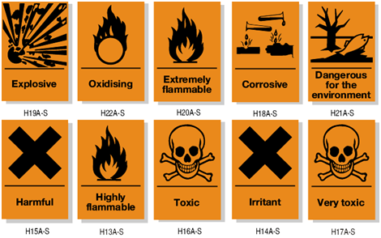
Chemical Safety
The use of chemicals within the labs should be kept to a minimum. Hazards increase with the quantity stored.
Anyone intending to introduce a chemical substance into the Group should obtain as much information as possible concerning the hazards associated. If the hazards are considerable, the availability of a safer alternative substance should be investigated
There will be provision of a deionised water supply and chemical sumps within the GLADD1 Cleanroom for waste chemicals.
You should wear the appropriate recommended protection for chemical(s) used be they gloves, glasses, respirator, protective clothing etc.
Control of Substances Hazardous to Health (COSHH)‎ forms and working procedures are required for the safe use of many chemicals used for group activities. Please see myself if planning new activities requiring COSHH.
Fred Doherty, H&S Induction, GU
22
Notes:
22
22
22

Slide 23
Cryogenics Safety
Cryogenics within our groups current research would only include the Carbon Dioxide (Liquid withdrawal) based cooling system in lab 345 used for ATLAS upgrade cooling experiments.
As mentioned in the Gas section it has been risk assessed mainly for the possible serious risk of asphyxiation in the event of a gas leak but the system cooling pipework is also insulated and enclosed where possible to protect users from low temperatures.
Liquid nitrogen is occasionally used within the group therefore personal protective equipment (PPE) must be worn when handling cryogenics. This could include gloves, apron/overalls, face shield and appropriate shoes.
For further guidance on use of Cryogenic Substances please refer to : http://www.gla.ac.uk/services/seps/az/cryogenicsubstances/
if in any doubt about Cryogenic work you will be undertaking please contact your supervisor or a member of technical staff.
Fred Doherty, H&S Induction, GU
23
Notes:
23
23
23

Slide 24
LASER SAFETY
The current School Laser Supervisor for the School is Dr Jonathan Taylor (ext 0894). All new laser equipment should be registered with him and the siting and use of lasers in the School should also be discussed with him.
Registered laser operators are encouraged to complete the RPS Laser Safety Course. Staff must exercise the strictest control and take all necessary precautions when using lasers. The necessary precautions are summarised in the University Safety Handbook.
Research laboratory areas in which lasers are operating usually have illuminated warning signs outside them and it is important that these are switched on when the lasers are in operation, and are switched off when the lasers are inoperative.
In general, a laser should not be left operating in an unoccupied room unless an interlock system, which shuts off the laser in the event of an unauthorized entry, is installed.
In view of the exceptionally low maximum values for exposure, the following basic methods of protection must be considered:
Complete containment of the laser installation.
Screening of the operator.
Direct protection of the eyes.
Assessment of the installation for safety before the start of operations.
The designation, instruction and medical control of staff for laser work.
Full recommendations for the safe operation of laser systems will be found in the Laser Rules on laser safety obtainable from the Laser Supervisor.
SCHOOL LINK : http://www.gla.ac.uk/media/media_383368_en.pdf /
UNIVERSITY LINK : http://www.gla.ac.uk/services/radiationprotection/non-ionisingradiations/
RPS Laser Safety Course. - http://www.gla.ac.uk/services/radiationprotection/lasersafetycourse/
Fred Doherty, H&S Induction, GU
24
Notes:
24
24
24

Slide 25
Working Outwith Normal Hours
It is important that you comply with the following instructions when working out with normal hours:
Record your arrival and departure in the log book provided at the basement entrance.
Plan what you are doing to reduce the risk of fire to a minimum.
Acquaint yourself with the whereabouts of the nearest exit, fire extinguisher, and light switches for corridors and stairs leading to the nearest exit.
Potentially dangerous operations must never be undertaken out with normal hours unless a second responsible person is present. Such operations should be restricted to normal hours when medical and other services are readily available.
Research students who intend to work late must inform a senior member of the group, and give details of the work they intend to do.
It is strongly advised that inexperienced personnel should be accompanied by experienced personnel when working late. If there is a serious injury, dial 4444 and ask for an ambulance. If no First Aider is available in Kelvin Building contact Main Gatehouse Ext 4282 and First Aid trained Security Staff will attend.
Fred Doherty, H&S Induction, GU
25
Notes:
25
25
25

Slide 26
SAFETY & TRAVEL - FIELDWORK
Safety & Travel - Working away from the University
When staff are working away from the University, Research Group Leaders (RGL) are responsible for ensuring a safe working environment. In general, work will be carried out in another institution that the RGL is familiar with and has similar levels of safety to the University of Glasgow.
If staff are planning to undertake fieldwork or are going to a new institution then they should undertake a risk assessment and discuss with their RGL.
It is the responsibility of the line manager (or other identified member of staff) to ensure that the employee is as well prepared for the trip as possible.
Fred Doherty, H&S Induction, GU
26
Notes:
26
26
26

Slide 27
