Slide 1
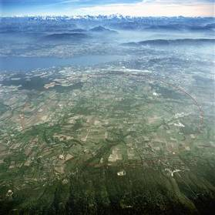


July Revolution 2012:
Higgs (or something like it) discovery at the LHC
Theory
Machine
Experiment
(Glasgow Role)
Q&A
Tony Doyle
Professor, University of Glasgow

Slide 2


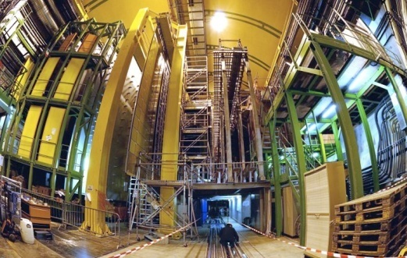
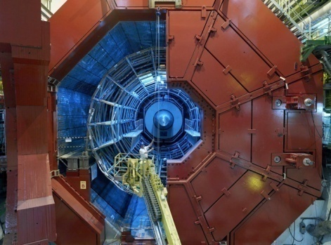


Enter a New Era in Fundamental Science
Start-up of the Large Hadron Collider (LHC), one of the largest and truly global scientific projects ever, is the most exciting turning point in particle physics.
CMS
LHCb
Exploration of a new energy frontier
Proton-proton and Heavy Ion collisions
at E_{CM} up to 14 TeV
ALICE
LHC ring:
27 km circumference
TOTEM
LHCf
MOEDAL
ATLAS
Notes:
2

Slide 3


1. THEORY

Slide 4
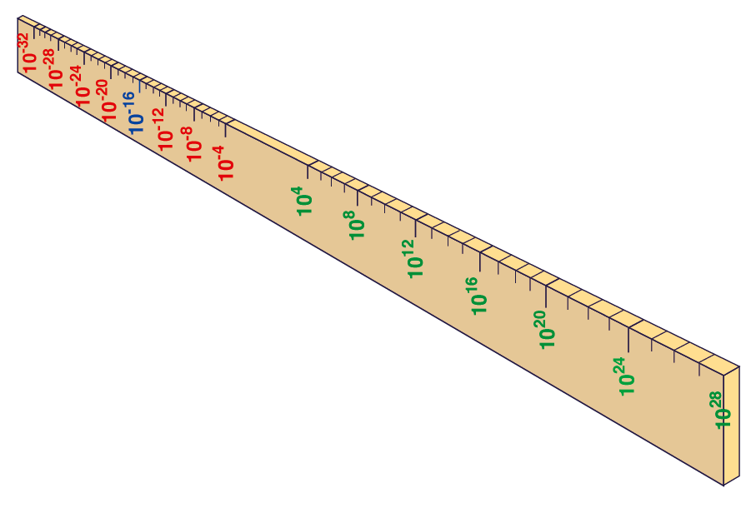
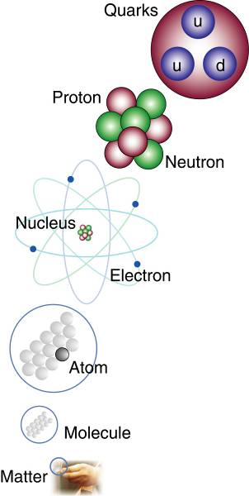
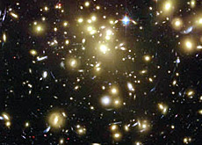
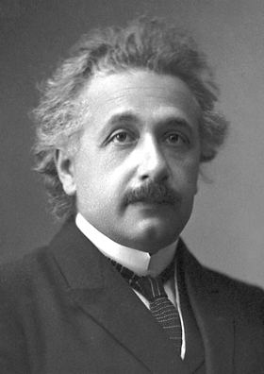


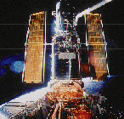
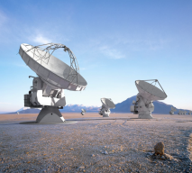

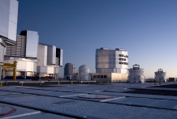
Big Bang
Proton
Atom
Radius of Earth
Earth to Sun
Radius of Galaxies
Universe
LHC
Super-Microscope
Hubble
ALMA
cm
Study physics laws of first moments after Big Bang
increasing Symbiosis between Particle Physics,
Astrophysics and Cosmology
AMS
VLT
Notes:
4
60 Grössenordnungen

Slide 5
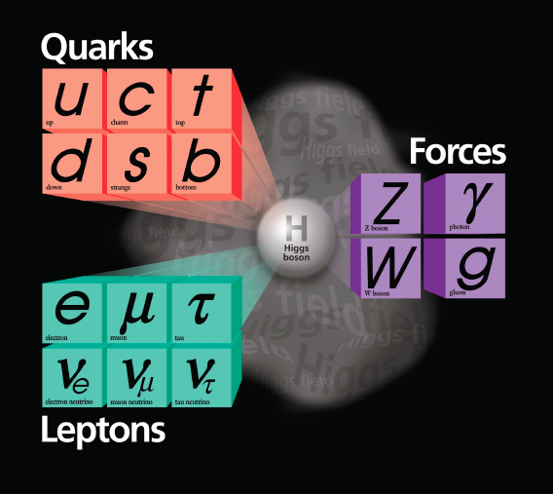
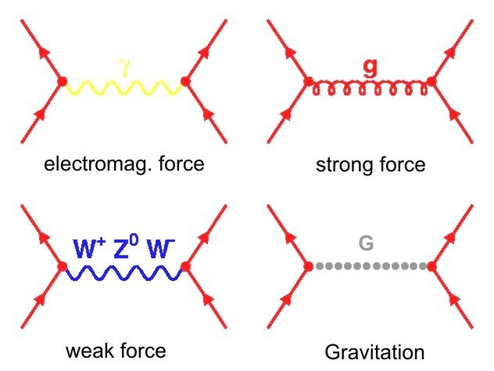
The Standard Model of Particle Physics
(i) Constituents of matter: quarks and leptons
Four fundamental forces
(described by quantum field theories, except gravitation)
(iii) The Higgs field (problem of mass)

Slide 6
Physics at the LHC corresponds
to conditions around here

Slide 7

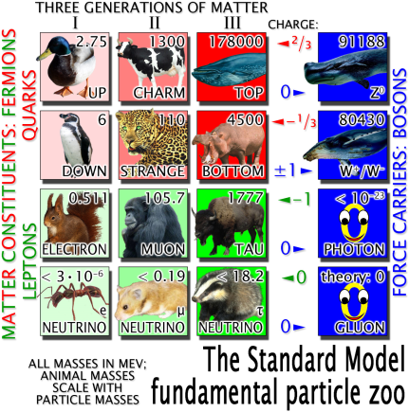
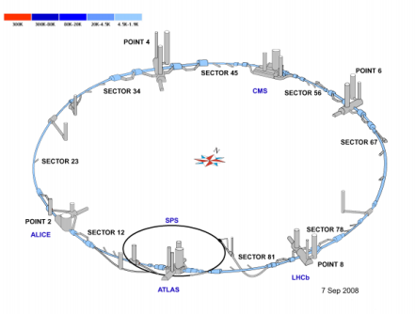
Universe – Particles – LHC?

Slide 8
ELEMENTARY PARTICLE MASSES
top quark
Mass proportional to area:
Are these made of something else? Are there more quark-, neutrino-,and electron-like particles?
ν_{e} ν_{μ} ν_{τ} e μ τ u d s c b
. . .
H?
Z
W
photons
gluons

Slide 9
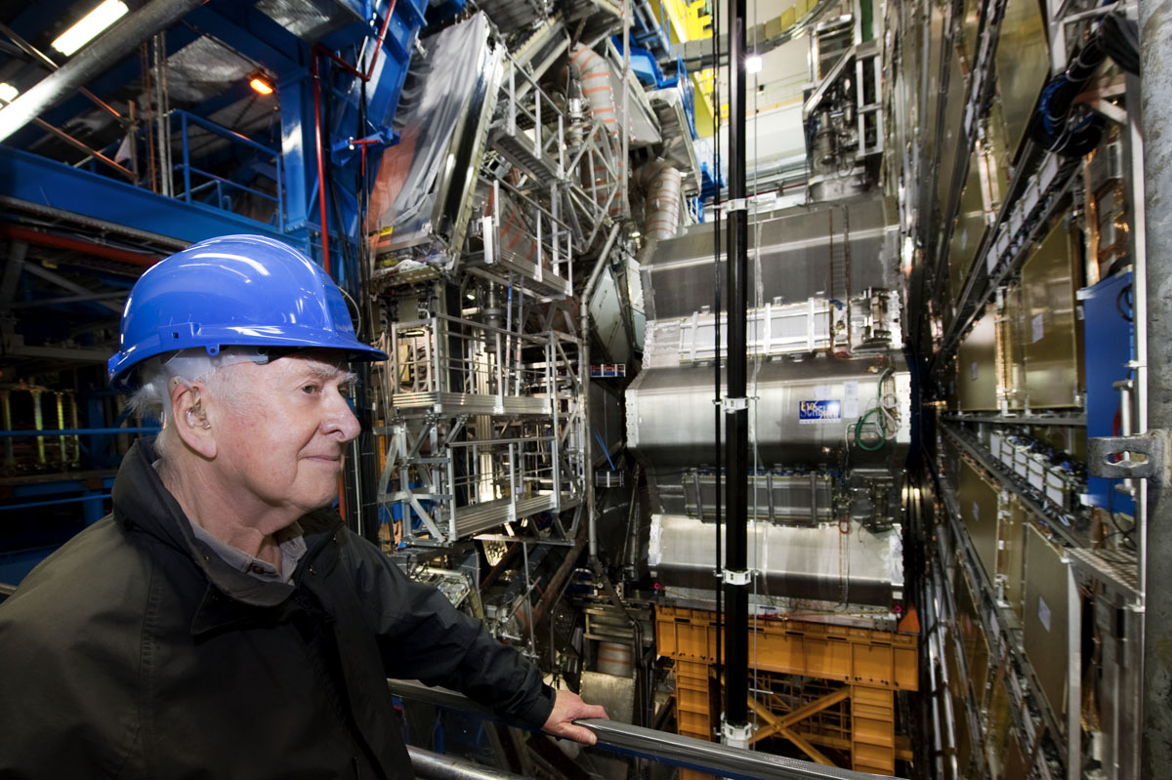
Where Theory Meets Experiment: 14th April 2008

Slide 10

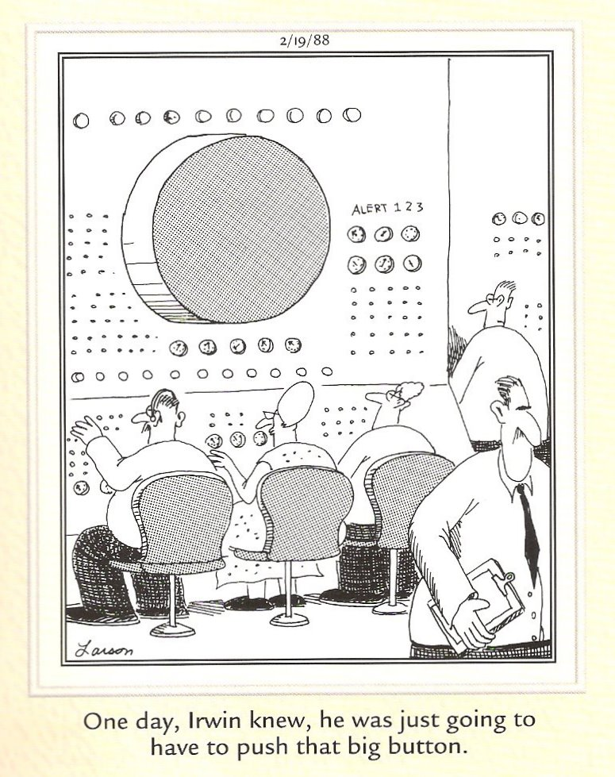
2. MACHINE
Particle Colliders
highest resolution? (LHC)

Slide 11
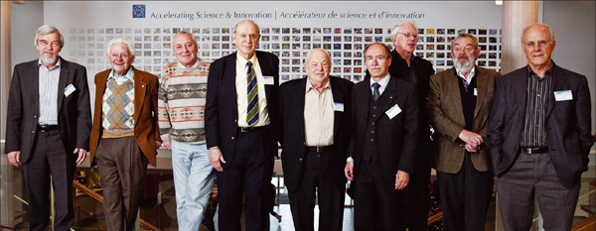
CERN
20 member states
  Big 4: Germany, UK, France, Italy - 60%
  + associates: USA, Russia, China, India…
2500 staff (78 permanent research physicists),
8970 users
562 Universities/Institutes
50+ experiments – 4 big LHC experiments
50 years of SPS – December 2009,
Included 13 Nobel prize winners

Slide 12
Organisation/Operation
Simplified concept….
CERN – provides accelerator, infrastructure
  24/7, with say 3 month winter accelerator shutdown
Users – design, construct, operate, analyse data from experiments
  Form experimental collaborations (600-3000 physicists)
    Develop organisational structure: spokesperson, technical co-ordinator, project leaders for components…
  Contribute to detector
  Members of collaboration can analyse any data produced
    Papers approved by and carry names of whole collaboration

Slide 13
Synchrotron Particle Accelerators
Lorentz force F = q(E + v × B) note v = dr/dt
Energy gain = ∫ F.dr = q ∫ E.dr + dr/dt × B . dr = qV add energy by voltage drop
Economic solution:
The synchrotron
pulse of particles accelerated by E-field
bend round circle. Accelerate again (get the phase right!!)
keep radius constant. Increase B a little each pass as p increases
when required energy reached, reduce E, hold B constant – storage ring
ring of magnets
bend particles
p = qBr
p = momentum
r = radius
from
F_{B} = qvB = mv²/r
qB = mv/r
qB = p/r
pulse of
charged
particles
Oscillating E-field

Slide 14
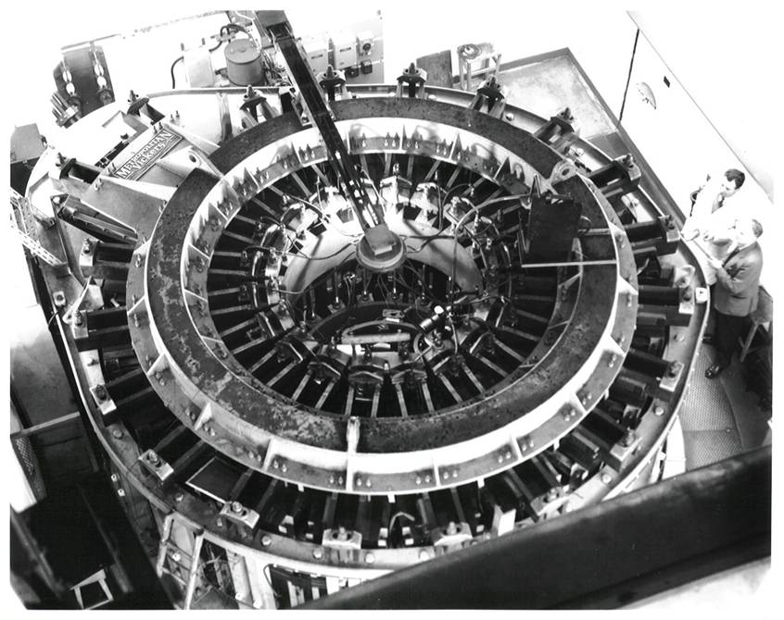
Heritage - Past
The first electron synchrotron in Europe was constructed in Glasgow in the 1950s
E = 300 MeV

Slide 15
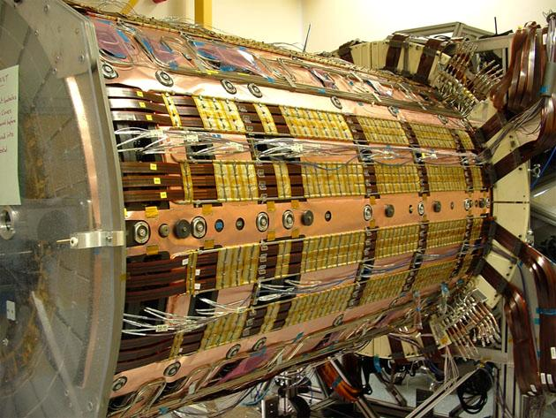
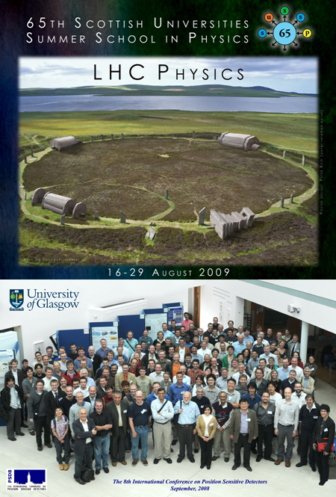
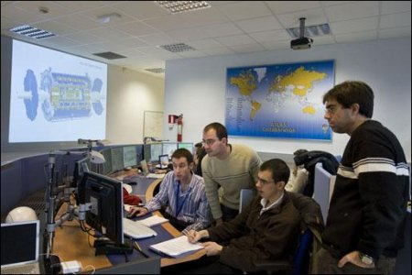
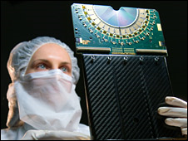
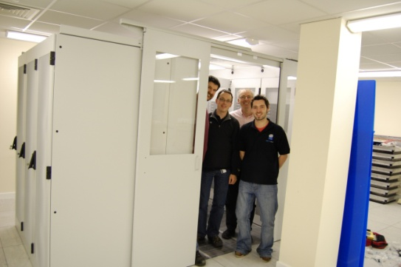

Research Context
Experimental particle physics is performed on a large scale
Our major aims are to discover :
1. the Higgs Boson
2. the nature of the matter-antimatter asymmetry in the Universe
We have been actively preparing for the Large Hadron Collider (LHC) for 15 years with developments in analysis, detectors and computing via the Grid

Slide 16
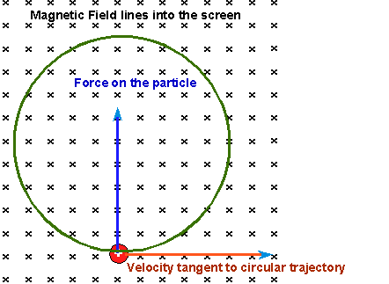
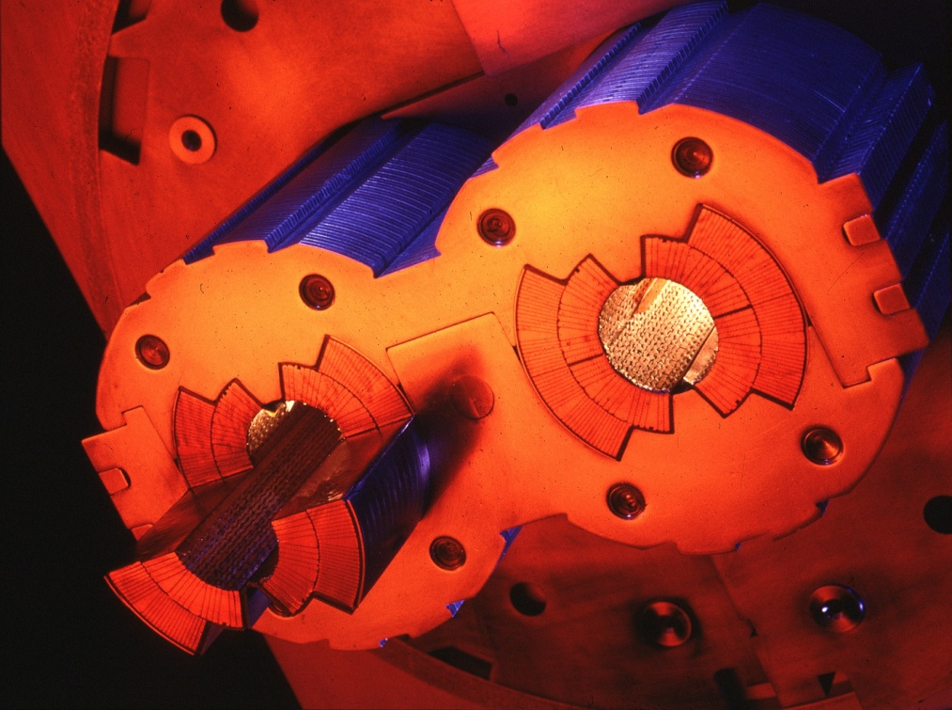

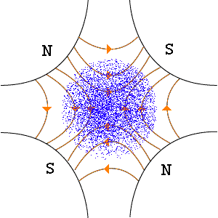
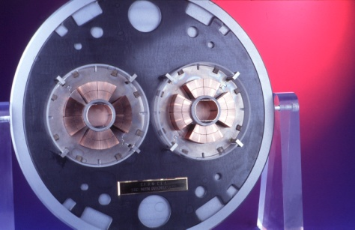
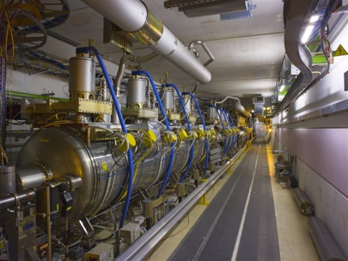
The LHC is a Synchrotron
Magnets
  Dipoles
    Keep particles on circular orbit
  Quadrupoles
    Limit the divergence of the beam (beam stability)
    Focus beams on interaction points to obtain high luminosities
RF Cavities
  Boost particles at each turn (0.45 → 7 TeV)

Slide 17
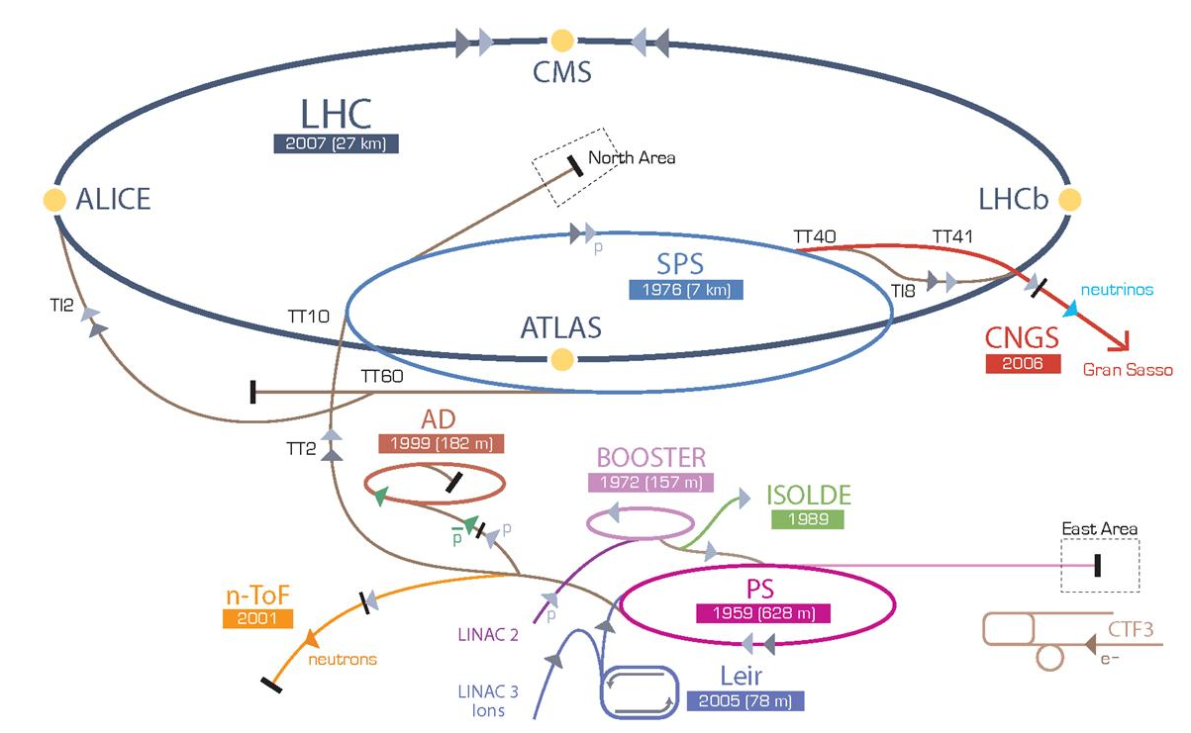
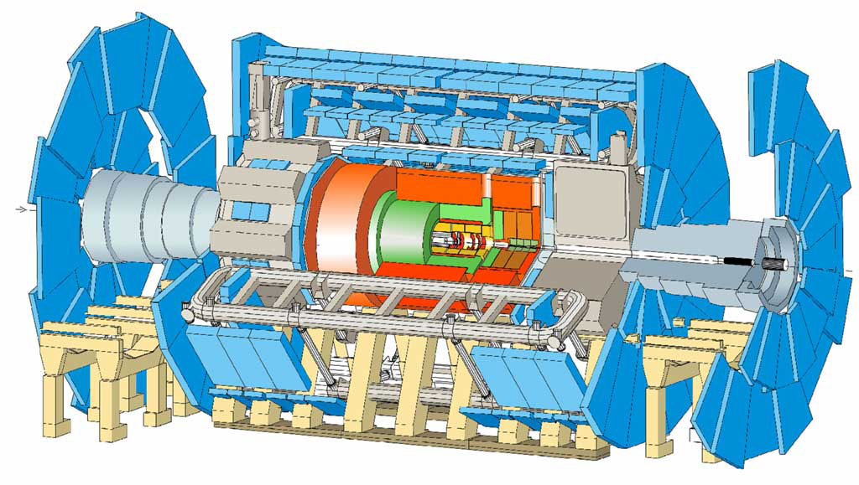
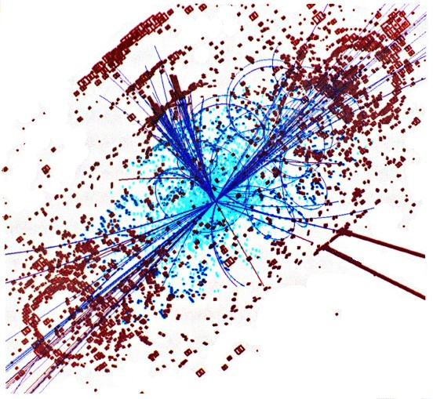
CERN’s particle accelerator chain

Slide 18
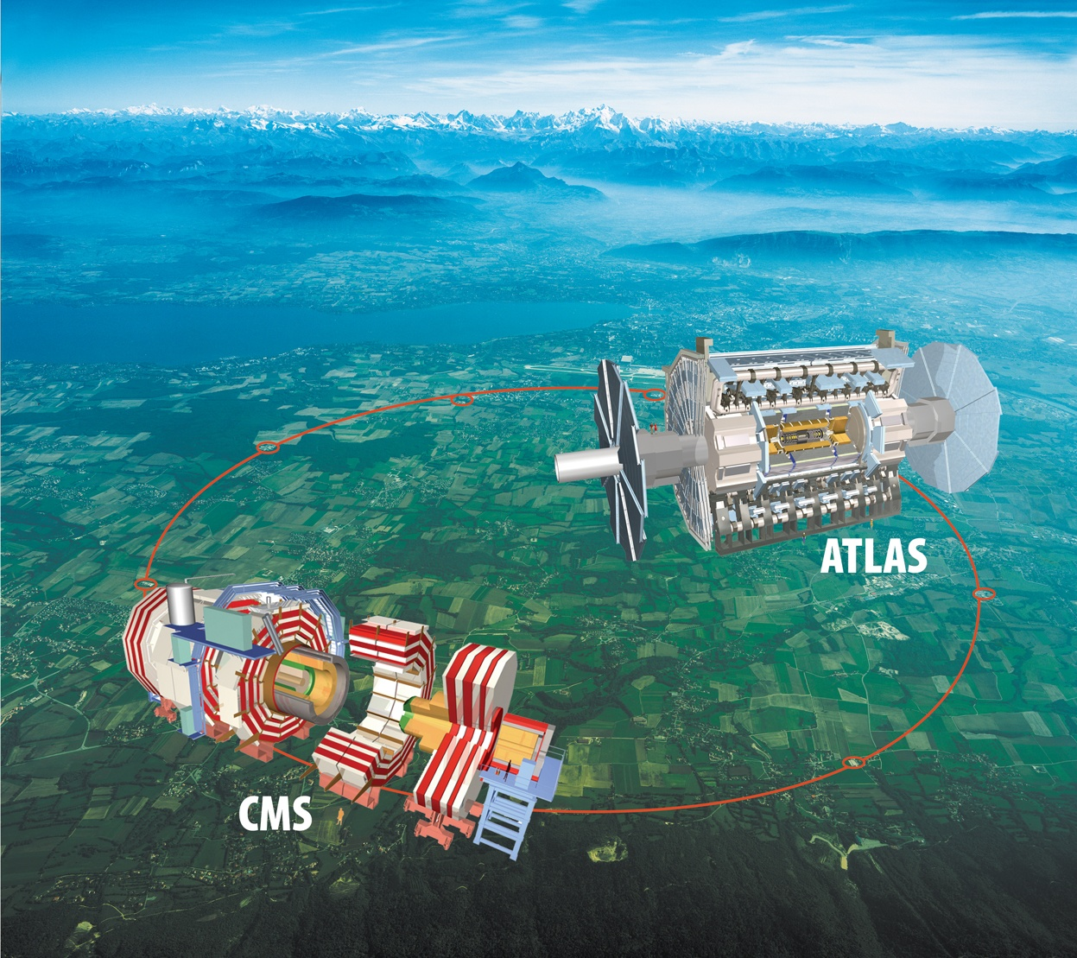

Slide 19
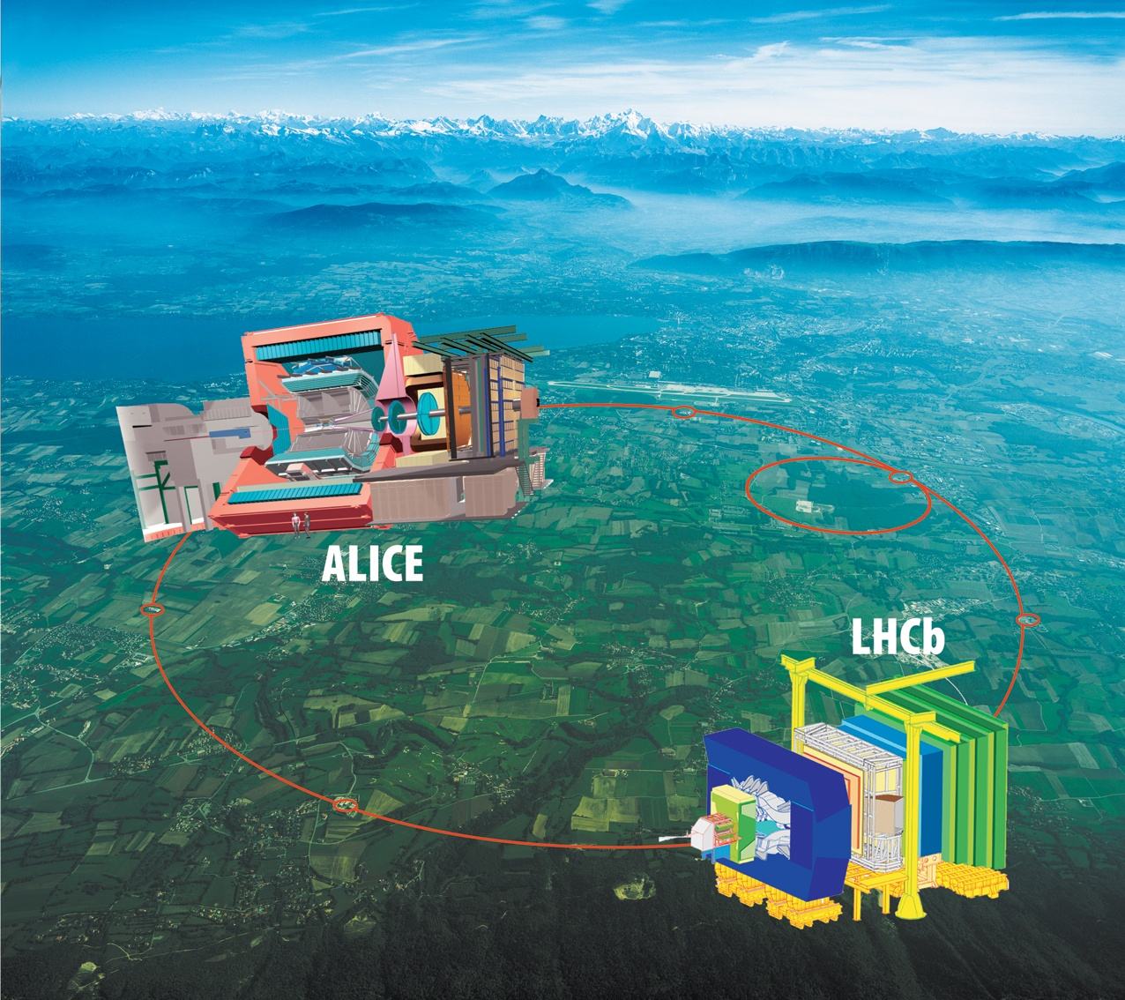
Specialized detectors

Slide 20
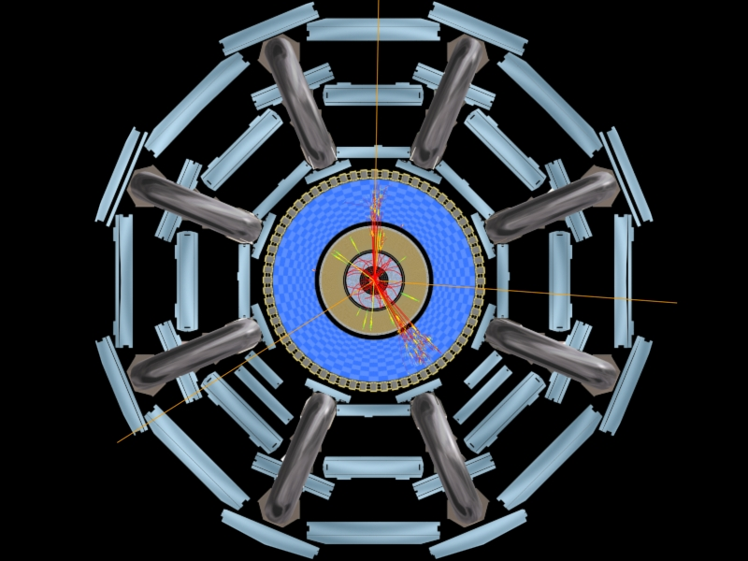
3. EXPERIMENT
Progress on ATLAS

Slide 21
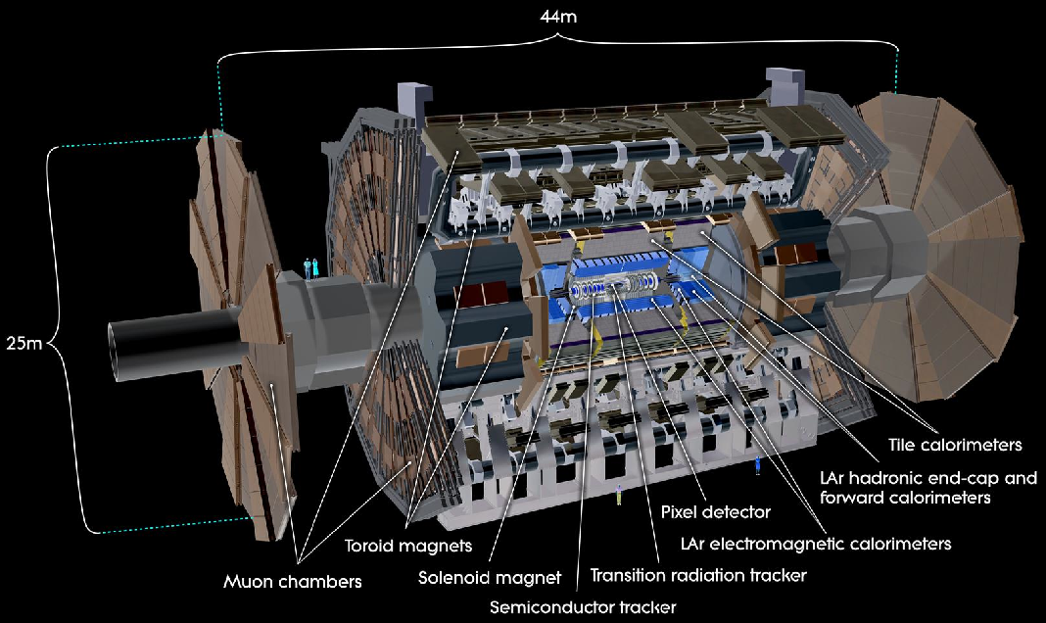
Muon Spectrometer (|η|<2.7) : air-core toroids with gas-based muon chambers
Muon trigger and measurement with momentum resolution < 10% up to E_{μ} ~ 1 TeV
3-level trigger
reducing the rate
from 40 MHz to
~200 Hz
38 Countries 174 Institutions
3000 Scientists 1000 Students
Length : ~ 44 m
Radius : ~ 12 m
Weight : ~ 7000 tons
~10⁸ electronic channels
3000 km of cables
Inner Detector (|η|<2.5, B=2T):
Si Pixels, Si strips, Transition Radiation detector (straws)
Precise tracking and vertexing,
e/π separation
Momentum resolution:
σ/p_{T} ~ 3.8x10⁻⁴ p_{T} (GeV) ⊕ 0.015
ATLAS Detector
EM calorimeter: Pb-LAr Accordion
e/γ trigger, identification and measurement
E-resolution: σ/E ~ 10%/√E
HAD calorimetry (|η|<5): segmentation, hermeticity
Fe/scintillator Tiles (central), Cu/W-LAr (fwd)
Trigger and measurement of jets and missing E_{T}
E-resolution: σ/E ~ 50%/√E ⊕ 0.03

Slide 22
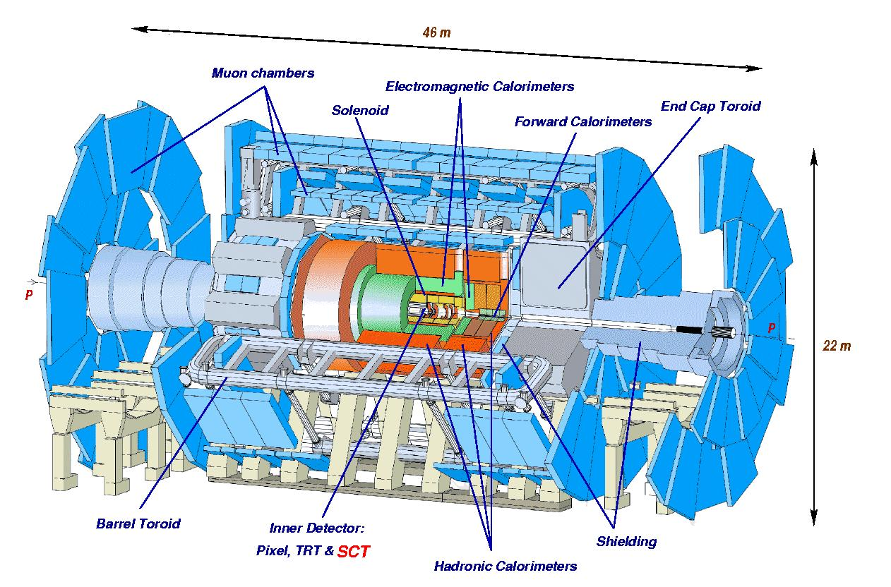
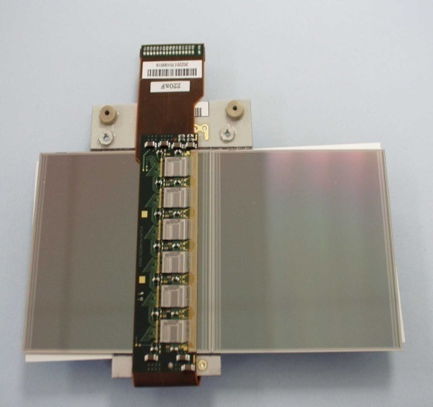
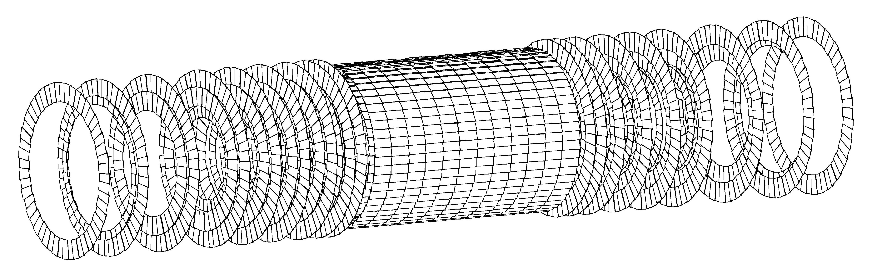
The ATLAS Detector
ATLAS = large international collaboration to find the Higgs
(and much more) in the range 0.1TeV < m_{H} < 1TeV
The ATLAS experiment is 44m long, stands 22m high and weighs 7000 tonnes
SCT alone has 6.2 million read-out channels

Slide 23
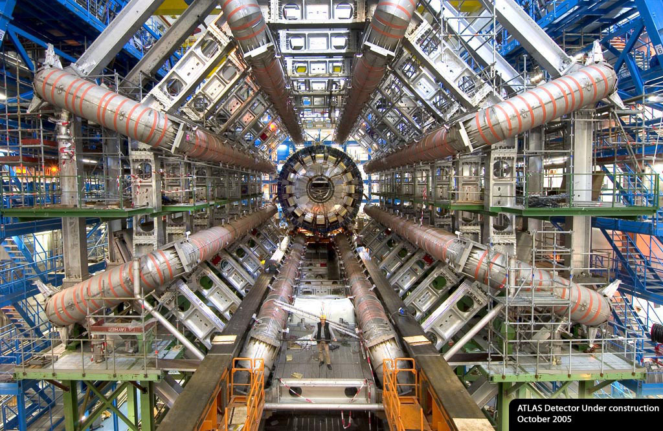
A question of scale

Slide 24
The Grid
The Grid enables us to analyse all the data that comes from the LHC
Petabytes
100,000 CPUs
Distributed around the world
Now used in many other areas

Slide 25
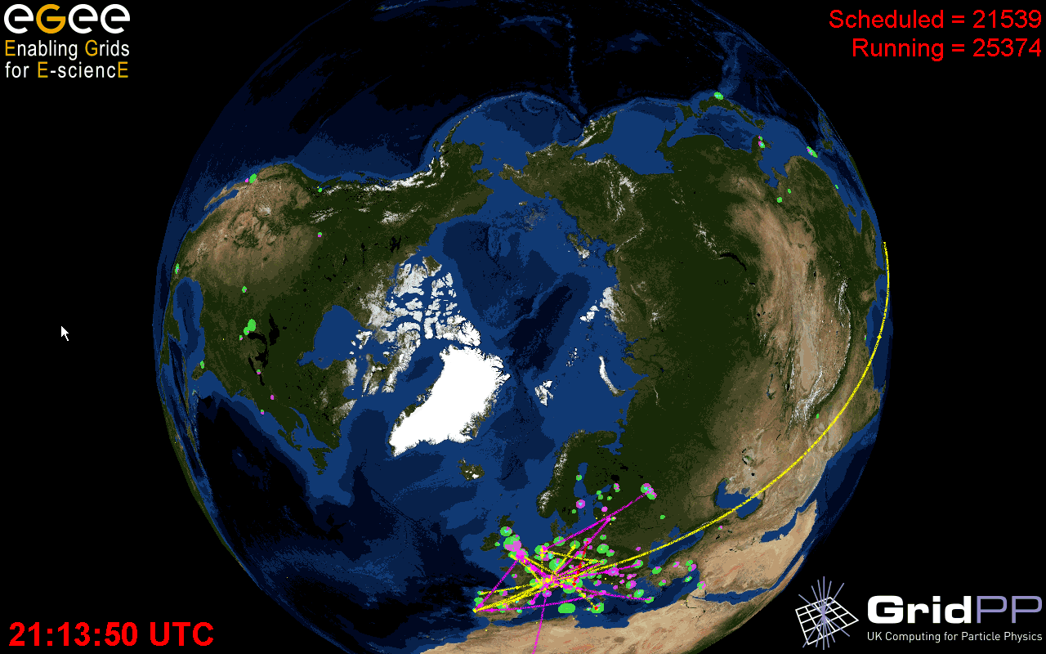
The Grid
  Archeology
  Astronomy
  Astrophysics
  Civil Protection
  Comp. Chemistry
  Earth Sciences
  Finance
  Fusion
  Geophysics
  High Energy Physics
  Life Sciences
  Multimedia
  Material Sciences
  …
>250 sites
48 countries
>50,000 CPUs
>20 PetaBytes
>10,000 users
>150 VOs
>150,000 jobs/day
Notes:
25

Slide 26
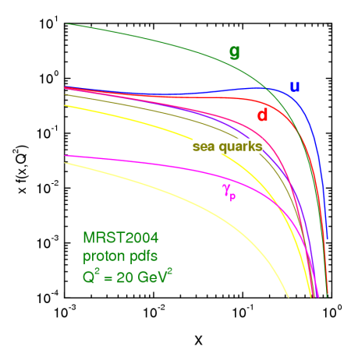
LHC MOTIVATION:
HIGGS PRODUCTION IN PP COLLISIONS
q
Z⁰
q₁
W
W
H
q₂
p
p
Z⁰
q
M_{H} ≤ 1 TeV
E_{W} ≥ 0.5 TeV
E₁ ≥ 1 TeV
E₂ >≥ 1 TeV
Parton luminosities
E_{cm}=√(4x₁x₂.E_{p}E_{p})
Proton Proton Collider with E_{p} = 7 TeV
(currently 3.5 TeV)

Slide 27
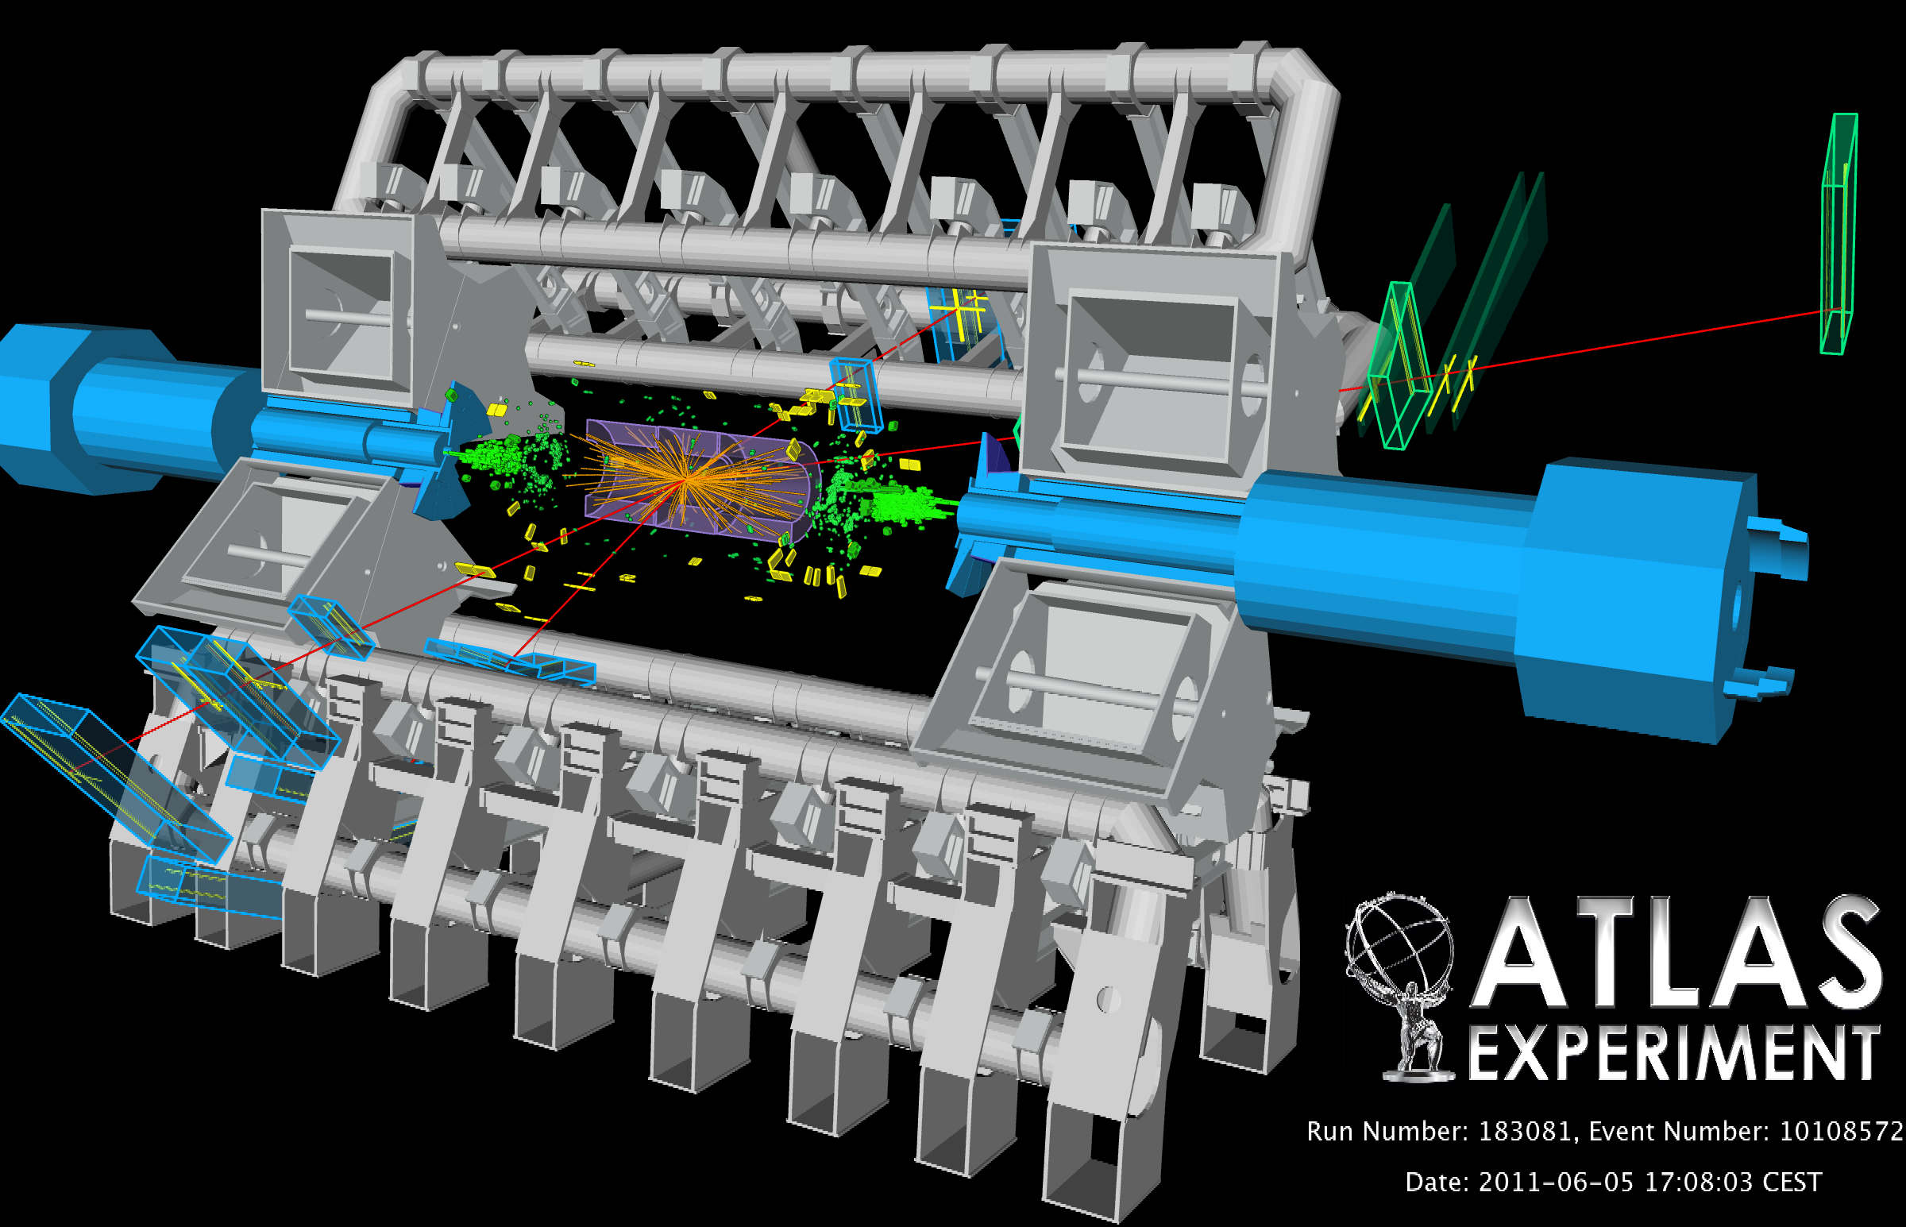
LHC REALITY:
HIGGS PRODUCTION IN PP COLLISIONS

Slide 28
The Higgs Search Landscape
95% CL Excluded Mass range
LEP
+
Tevatron
Tevatron
158
173
0
100
200
300
400
500
600
114
Low Mass
( M_{H}≈ 120 GeV )
H→γγ
H → WW
qqH→ττ
V+ H→bb
qqH→bb
V+ H→WW
Mid Mass
( M_{H} ≈ 160 GeV )
H→WW
H→ZZ
High Mass
( M_{H}≈ 400 GeV )
H→ZZ
H→WW

Slide 29
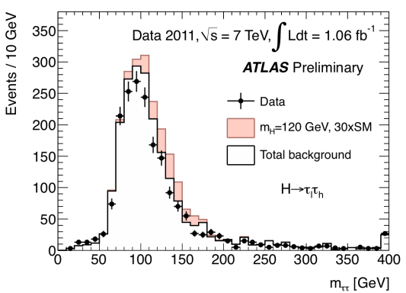
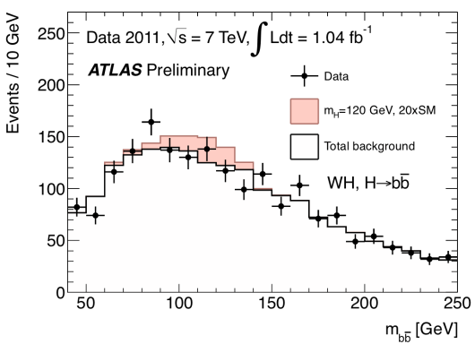
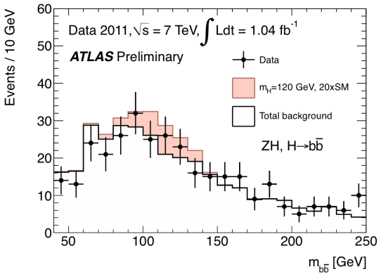
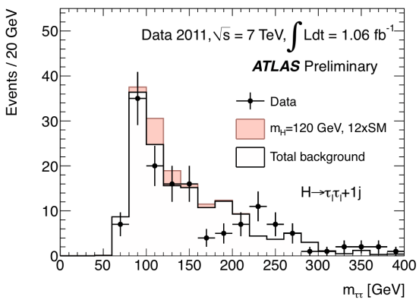
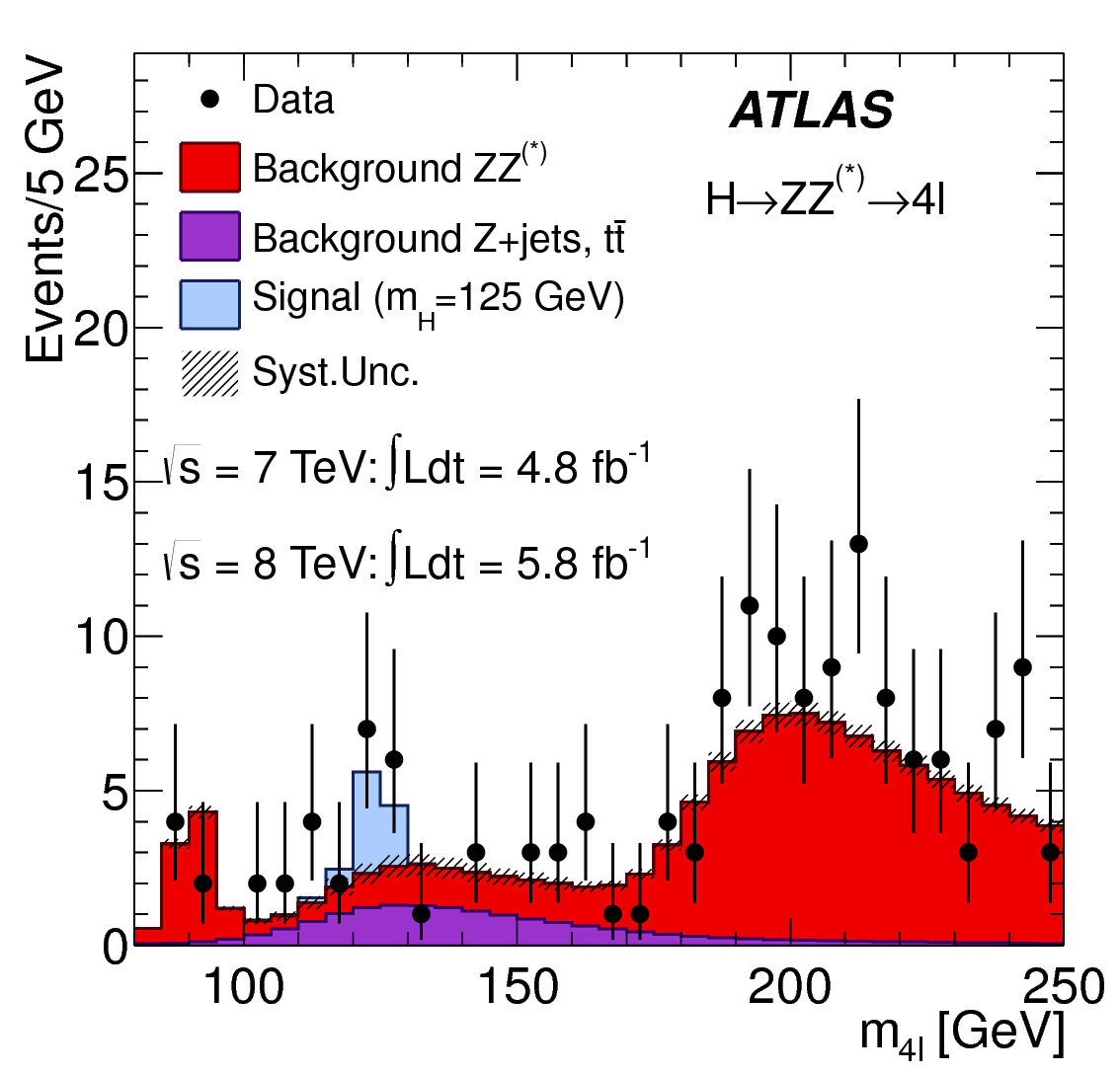
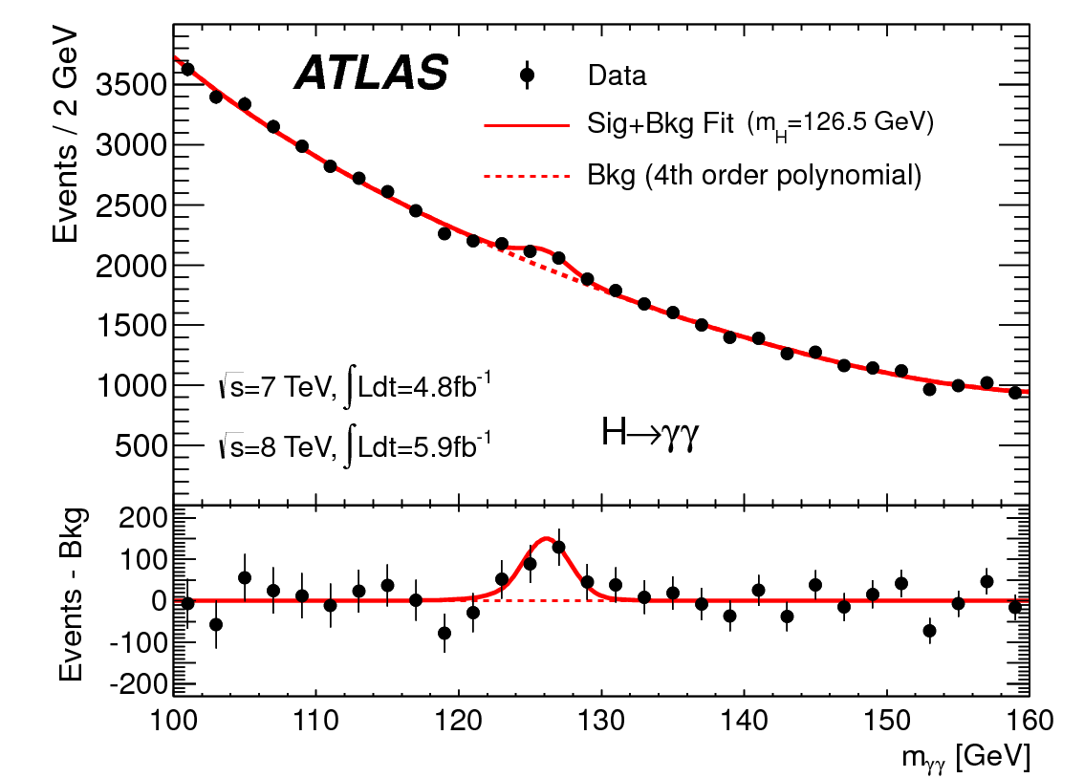
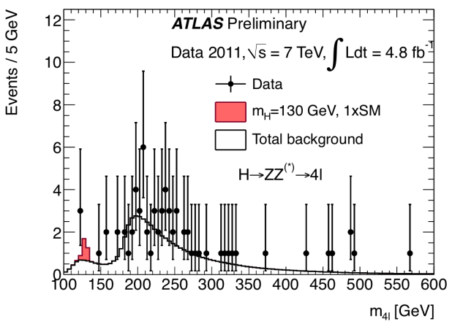
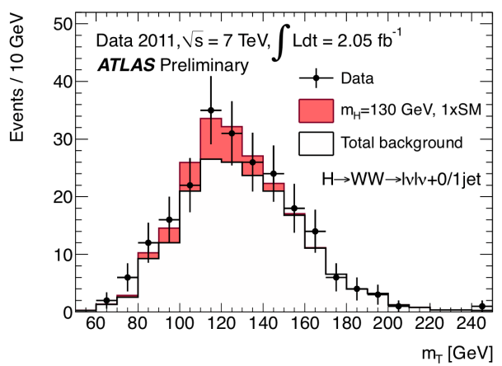





Update of Standard Model Higgs searches

Slide 30


What a month!
Publication to appear..
July Revolution (2012)

Slide 31



Supersymmetry
Conventional method to fix Higgs mass:
Invoke SUSY
Double the number of states in model
Fermion/boson loops cancel
Can also help to unify forces
105 new parameters (MSSM)
=> SUSY is a good pension plan for experimentalists!

Slide 32

Dark Matter at the LHC?
Characteristic signature for Dark Matter production at ATLAS:
Missing Transverse Energy (‘ME_{T}’)
Valid for any DM candidate
(not just SUSY)
Observation of ME_{T} signal necessary but not sufficient to prove DM signal (DM particle could decay outside detector)
~
χ⁰₁
ME_{T}
Combine LHC and Astroparticle physics data in order to prove that the neutralino hopefully observed at LHC would be the DM particle…
~
χ⁰₁

Slide 33

Extra Dimensions
Hypothesize that there are extra space dimensions
Volume of bulk space >> volume of 3-D space
Hypothesize that gravity operates throughout the bulk
SM fields confined to 3-D
Then unified field will have “diluted” gravity, as seen in 3-D
If we choose n-D gravity scale=weak scale then…
Only one scale -> no hierarchy problem!
Can experimentally access quantum gravity!
But extra dimension is different scale from “normal” ones
-> new scale to explain
Extra dimensions are more of a lottery bet than a pension plan!

Slide 34

BLACK HOLES AT THE LHC
If two particles pass close enough with enough energy, they may form a black hole
For 3 spatial dimensions, this will never happen –gravity is too weak. But with extra dimensions, gravity may become stronger, micro black holes can be created in particle collisions

Slide 35

SEARCH FOR EXTRA DIMENSIONS
If theories with Extra Dimensions are true, microscopic black holes could be abundantly produced and observed at the LHC
They decay immediately
through Hawking radiation
Simulation of a black hole
event with M_{BH} ~ 8 TeV in
ATLAS

Slide 36
Age distribution of the ATLAS population
All 2690 (< 35 y 47.2%)
Male 81.8% (< 35 y 44.0%)
Female 18.2% (< 35 y 61.3%)
(Status 1.1.2010)

Slide 37




!
EXCITING YEARS ARE AHEAD
CMS
LHCb
ALICE
LHC ring:
27 km circumference
ATLAS

